Slide 1
YOUR NAME
TITLE
Updated: 11/29/23

Slide 2

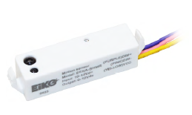


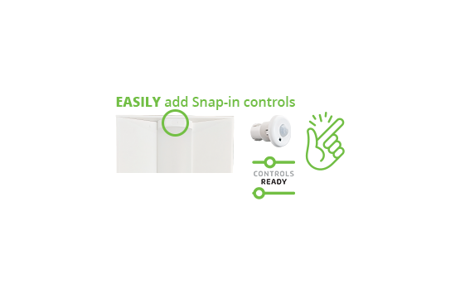
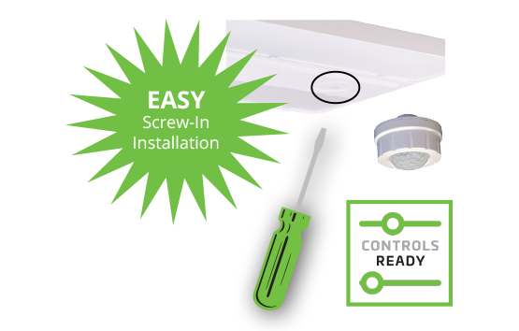
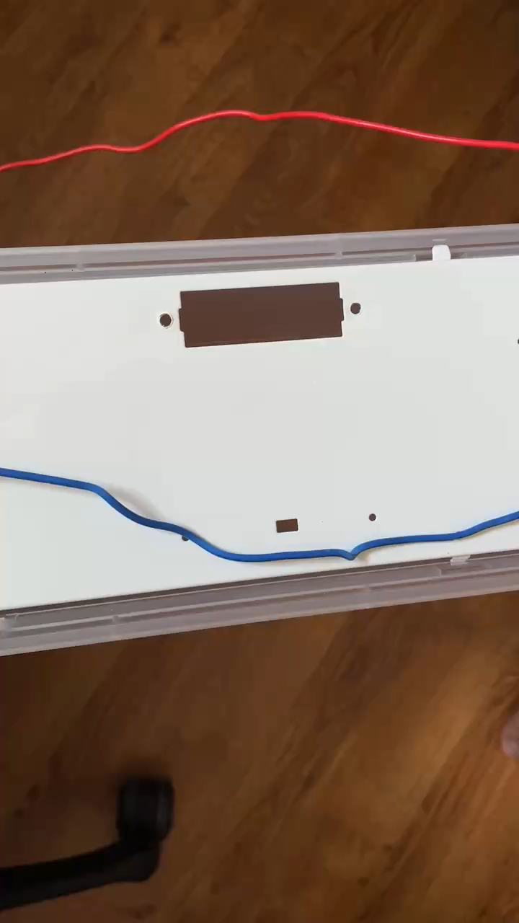
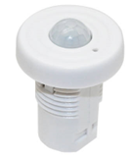
CONTROLS READY MAKES ADDING CONTROLS EASY
SENA-SHMR
Microwave – Behind the Lens (some wiring required)
EASY Snap-in Installation
SIMPLE EASY QUICK
No Wiring Required
Notes:
The reason for this is because many of EiKO’s products today are
that means, the fixture can easily accept standalone or networked lighting controls without the need for any wiring, either twist lock (press enter), screw in (press enter) or snap on the controls solution. It’s quick, it’s easy and simple.

Slide 3
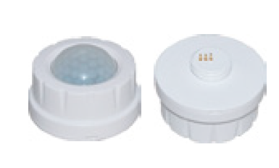
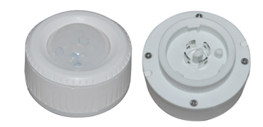
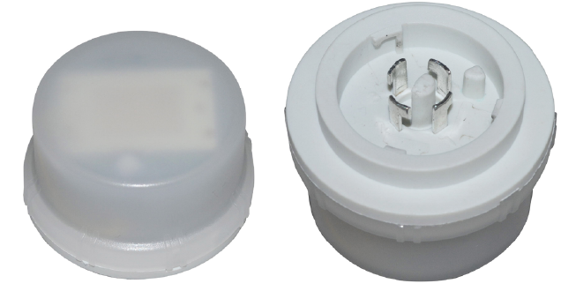
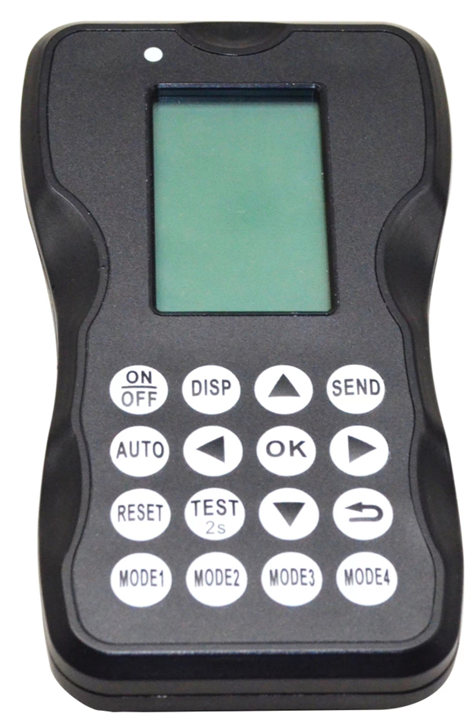
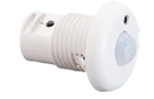
STANDALONE CONTROL SOLUTIONS
Dual ambient and daylight sensing technology
Daylight Harvesting
Occupancy Sensing
Photocell (Dusk-to-Dawn)
Two-stage dimming/Midnight Dimming
*Featured on select Sensors: SEN5A-SZPR-WH,
SEN5A-SZMR-WH, SENA-SHMR, SENA-SHPR
*Programmed via Commissioning Tool
Photocell
Daylight Harvesting
Occupancy
Ambient
& Daylight Sensing
Occupancy Sensing
SENSOR PROVIDES
PIR – Screw-in
PIR – Twist Lock
Microwave – Twist Lock
SEN5A-ACT
Microwave – Behind the Lens
PIR – Snap-In
Notes:
What is great about both of these sensors these sensors feature photocell capabilities (which we refer to as Ambient), they also have built in daylight harvesting and occupancy.
We refer to this as dual ambient and daylighting sensing technology.
Daylight Harvesting
Occupancy Sensing
Photocell (Dusk-to-Dawn)
Two-stage dimming/Midnight Dimming
These setting are set using a commissioning tool which I’ll talk more about in just a minute.

Slide 4
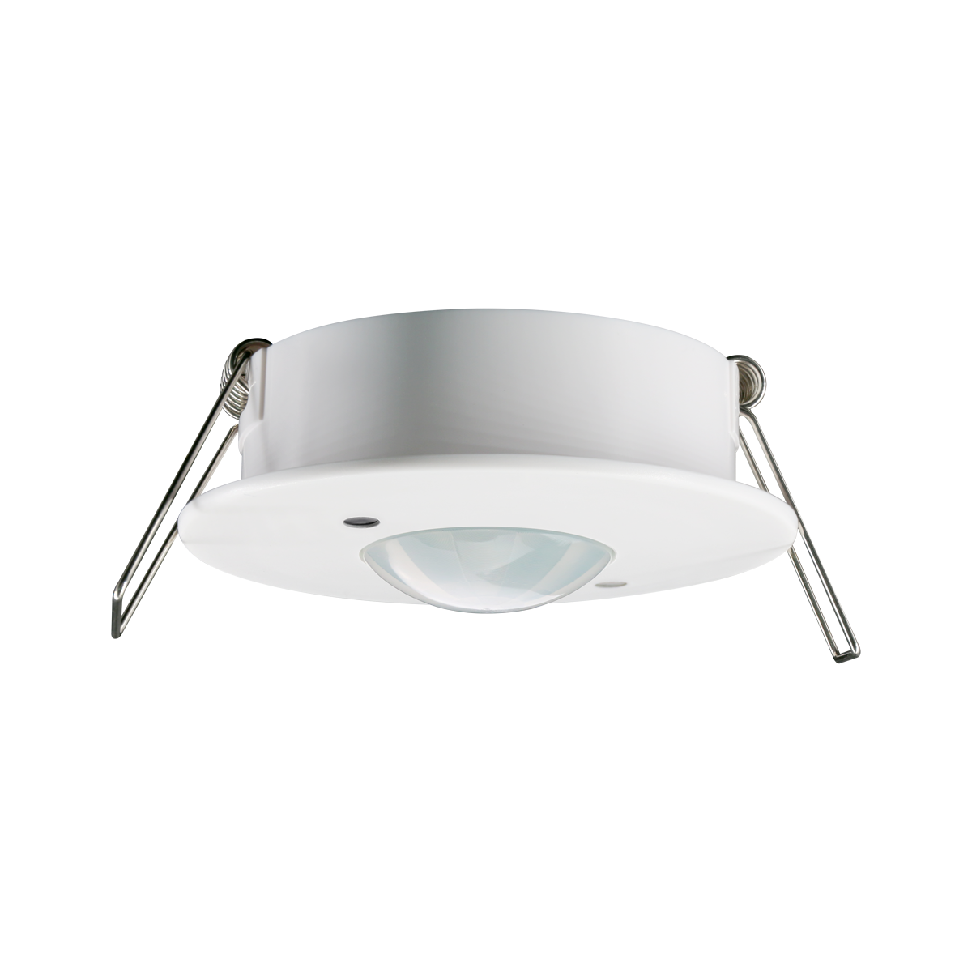



NETWORKED LIGHTING CONTROL SOLUTIONS
Networked:
Grouping/zoning, creating profiles (includes setting high- and low-end trim, occupancy or vacancy, daylight harvesting and time delay, ambient threshold
SENA-WZPA-WH
(PIR – Z10 Twist Lock)
SENA-WCPA
(PIR – Ceiling Mount)
SENA-WHPA
(PIR – Snap-in)
Powered by Silvair
Summary of EiKO’s NLC
Part of SIG (Special Interest Group)
No hubs, routers, gateways required
Fast data transfer, resilient radio
Scalable to thousands of devices (200 per zone, 8,000 per project)
No restriction on number of groups or zones
Reconfigures automatically when nodes are added, become blocked or inoperable = a more reliable system
Security
Stricter Rules
Interpretably/Communication with devices
Notes:
EiKO NLC system uses a Bluetooth low energy mesh to communicate among devices which is different from Wi-Fi and Zigbee because there is no central control device.
So Let me show you how it works. So here we have a number of nodes (an example of a node is a fixture controller, a sensor, a wireless controller or wall controller)
Press enter) we can easily take these nodes and split them into zones. In this case…. Zone 1 has 7 fixtures with one sensor, Zone 2 has two fixtures with a wireless controller. All Fixtures are equipped with a fixture controller. The fixture controller receives the signal from the sensor and or wireless or wall controller and then the fixtures react by maybe turning on or off or increasing or decreasing in intensity..
Press enter) So in example on the left When someone walks into Zone 1 the sensor sends a wireless signal out to the closest fixture, that fixture controller gets pick ups the signal and immediately floods the signal out to the next closest fixture controller and that continues to happen until all the fixtures in that zone are on. It happens very fast.
As a side note, Every node whether it’s a sensor, fixture controller, wall or wireless controller has a communication range so you will want to review the spec sheet for those details.
Press enter) to explain this further let’s say you have 8 fixtures in a zone. The wireless controller in this example needs to be within 32’ of one of the fixture controllers. This particular sensor has to be within 65’ of one of the fixture controllers and each fixture controller should not be placed any further away then 100’ from another fixture controller. Otherwise the mesh network will not work.
Press enter) so let’s look at in this other example when someone presses the wireless controller, the signal goes out to the closest fixture controller and the same thing happens, the signal floods out to all the other fixtures assuming the fixture controllers are within their max communication range.
Press enter) What’ sets EiKO’s NLC system apart from others is that there are no
Hubs, routers, gateways
It has a very Fast data transfer and a resilient radio
It’s Scalable to thousands of devices (200 per zone, 8,000 per project)
No restriction on number of groups or zones
Reconfigures automatically when nodes are added, become blocked or inoperable = a more reliable system
Press enter) EiKO is also part of the Special Interest Group (SIG) which means
Greater Security
Stricter Rules
And Interpretably/Communication with other devices

Slide 5
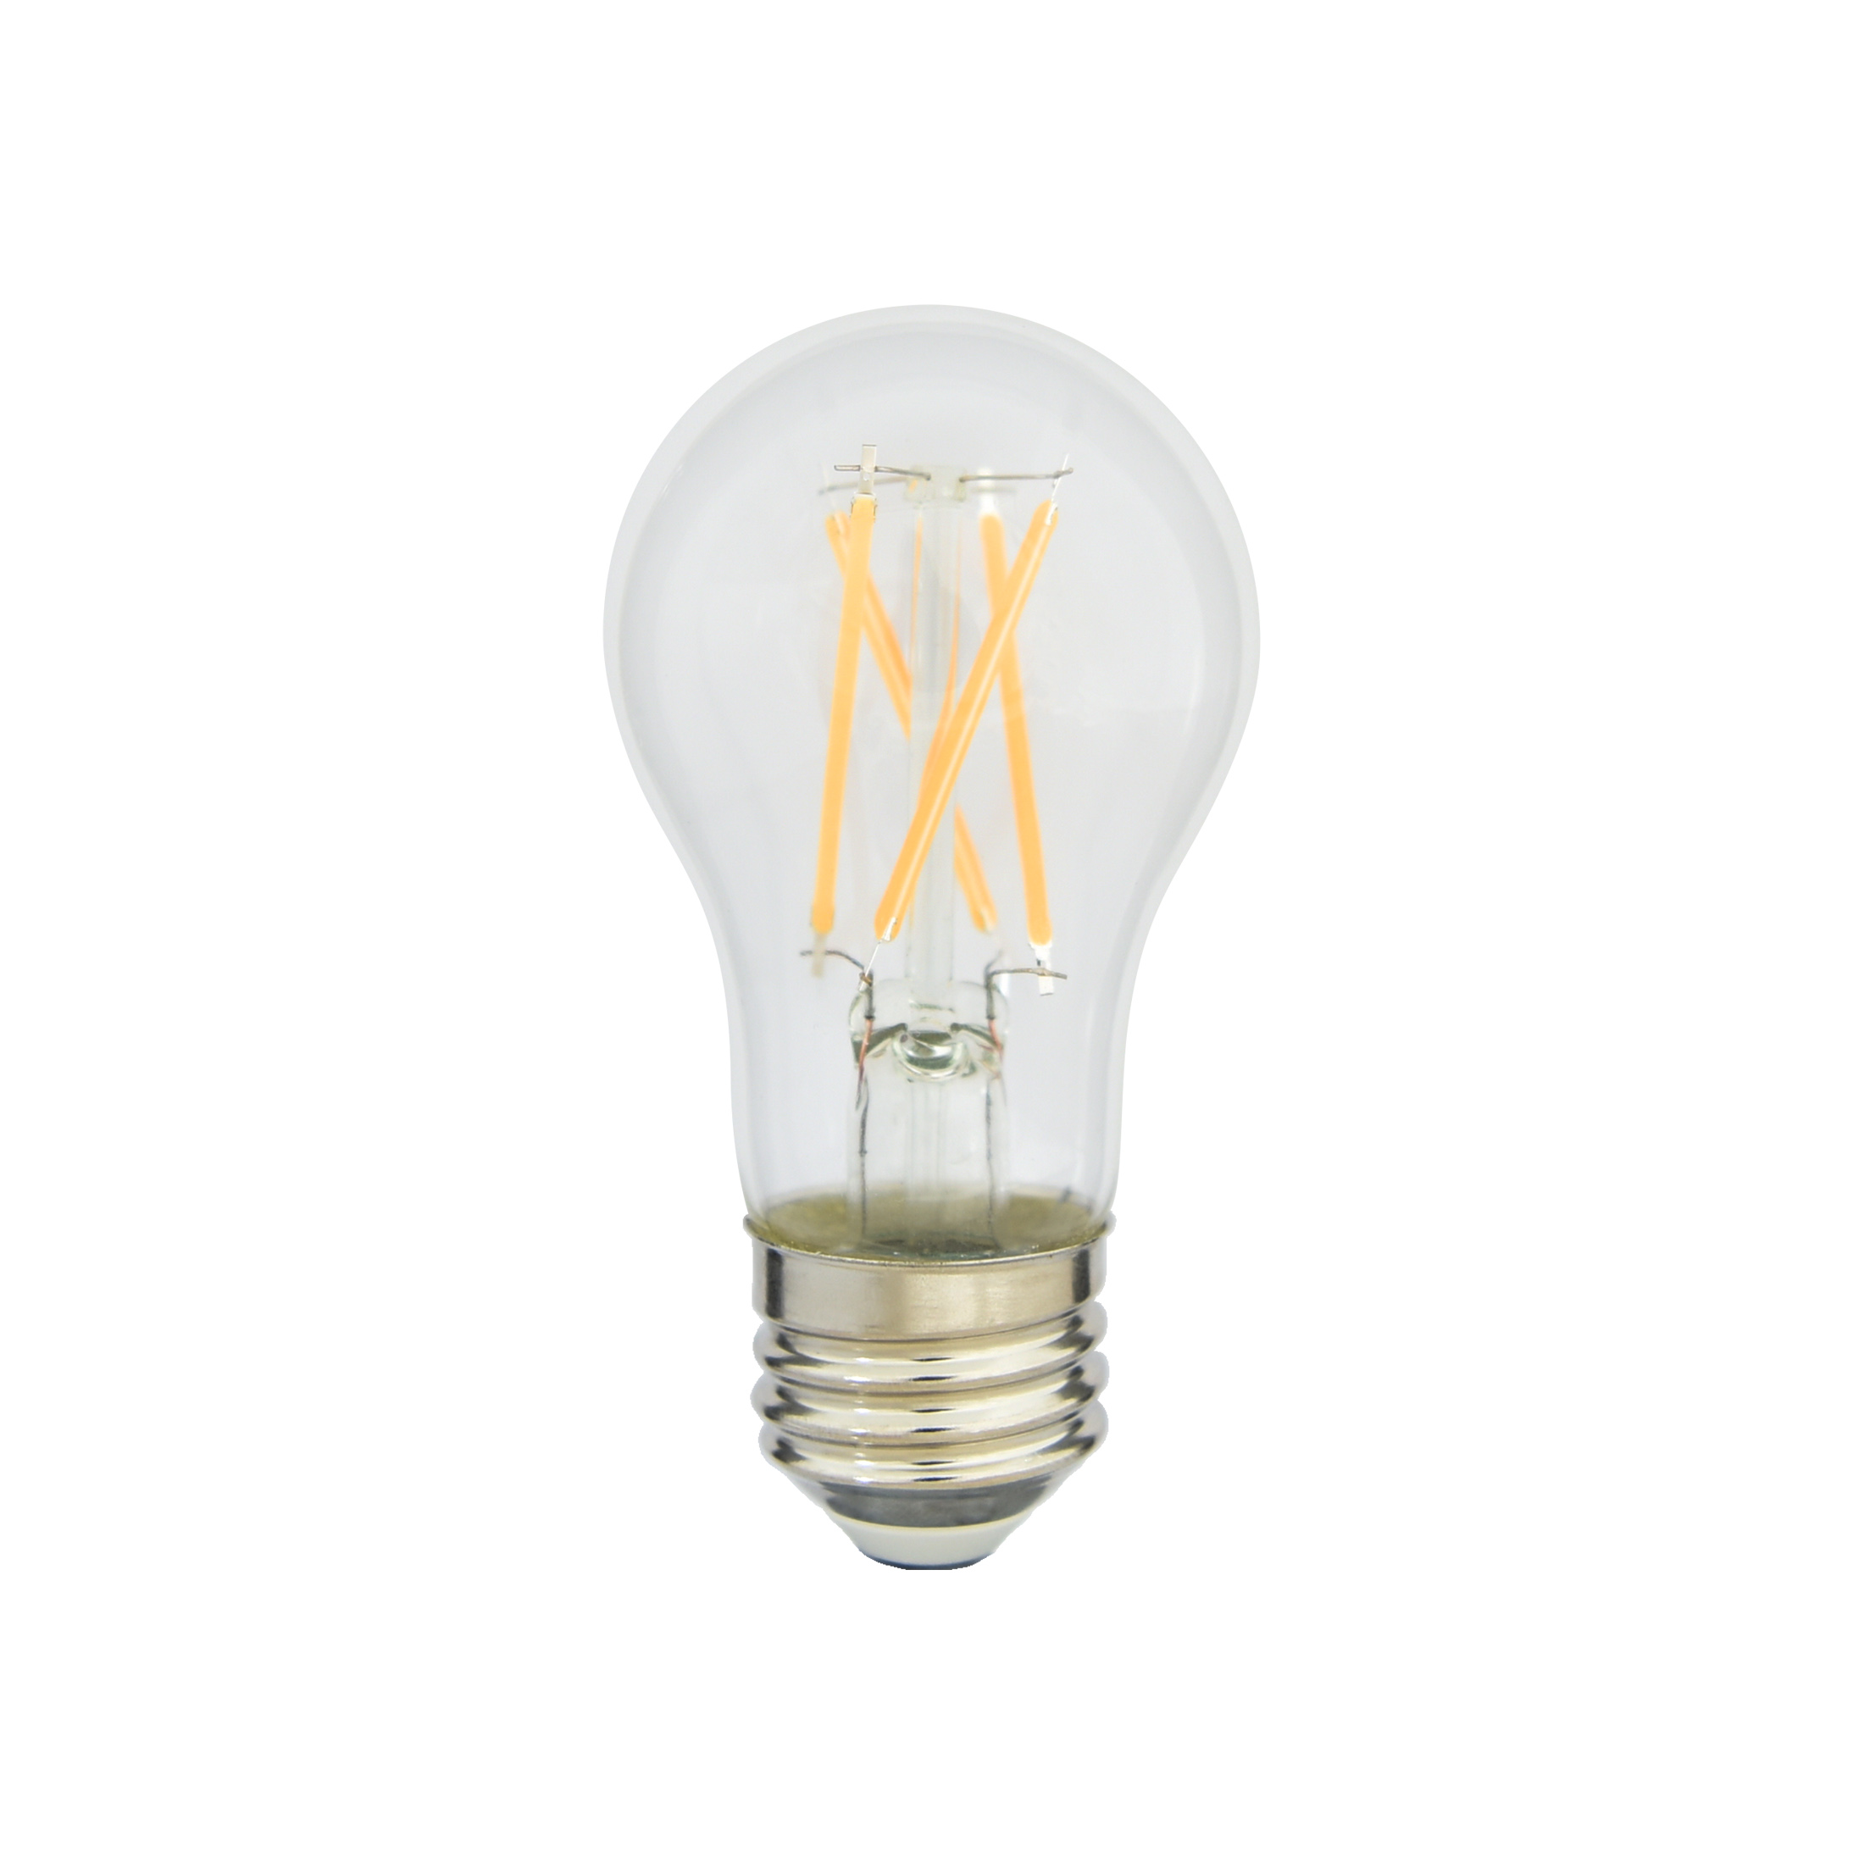
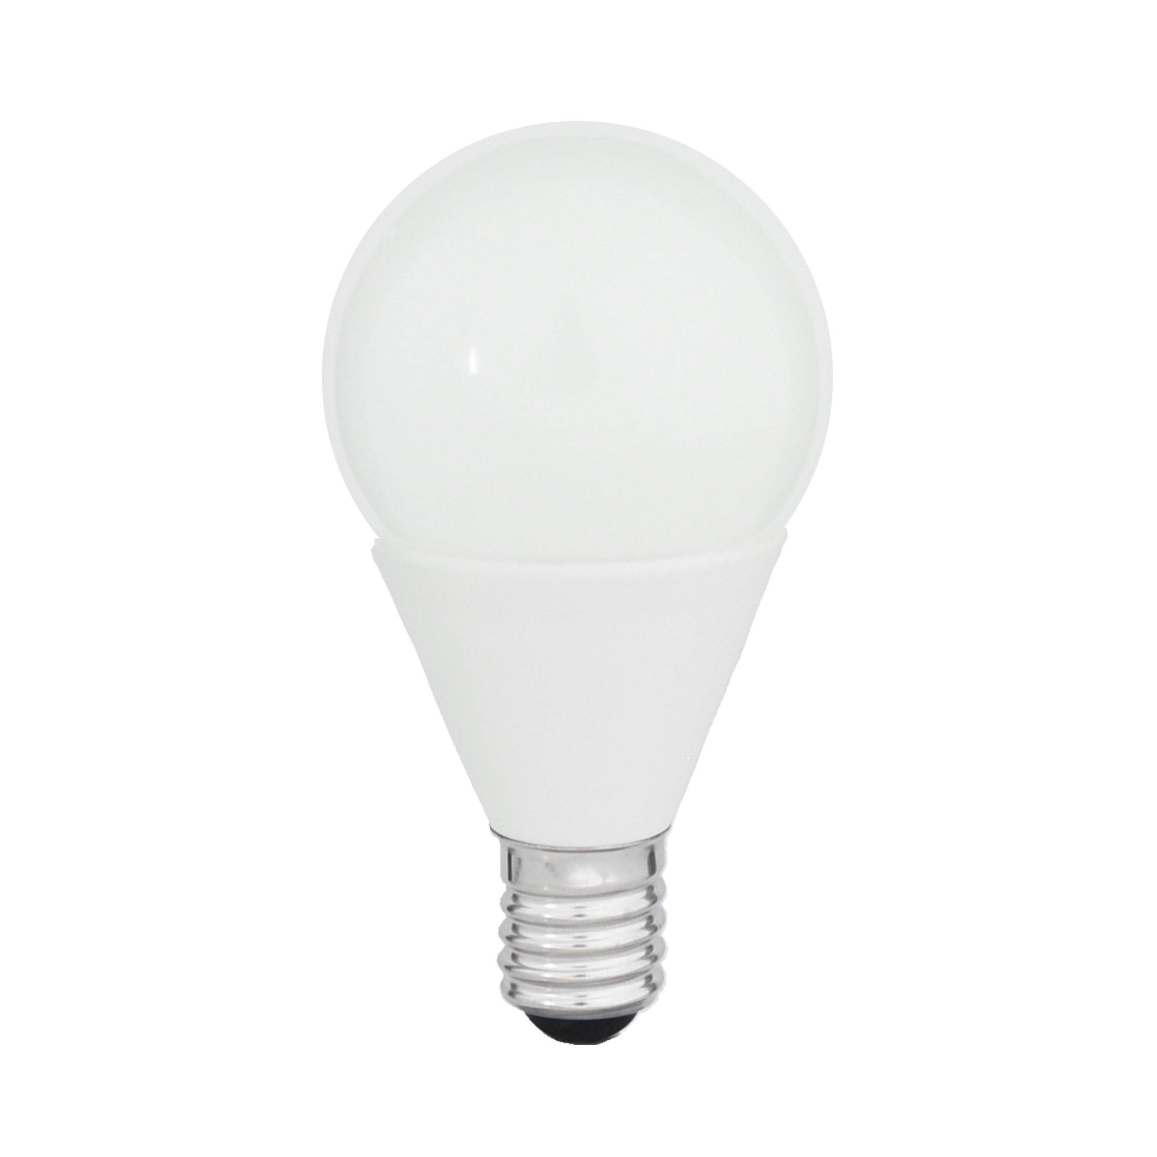
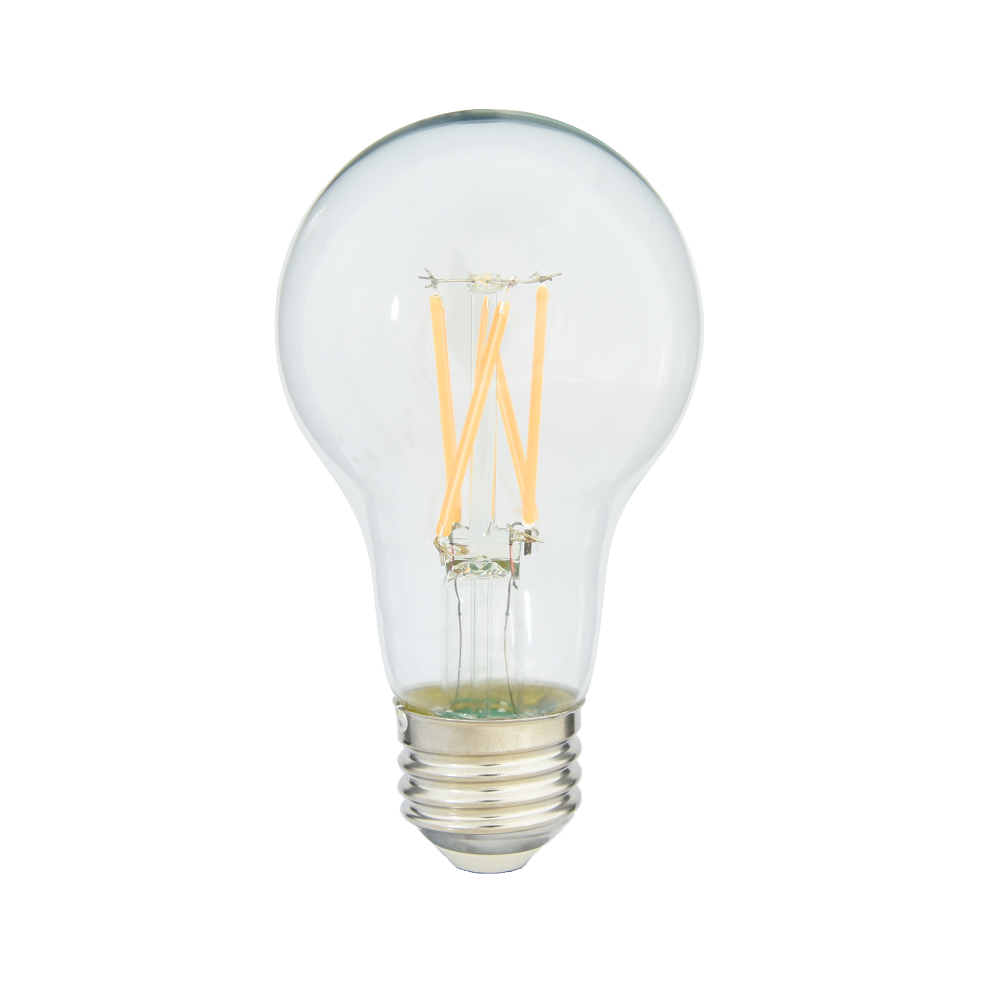
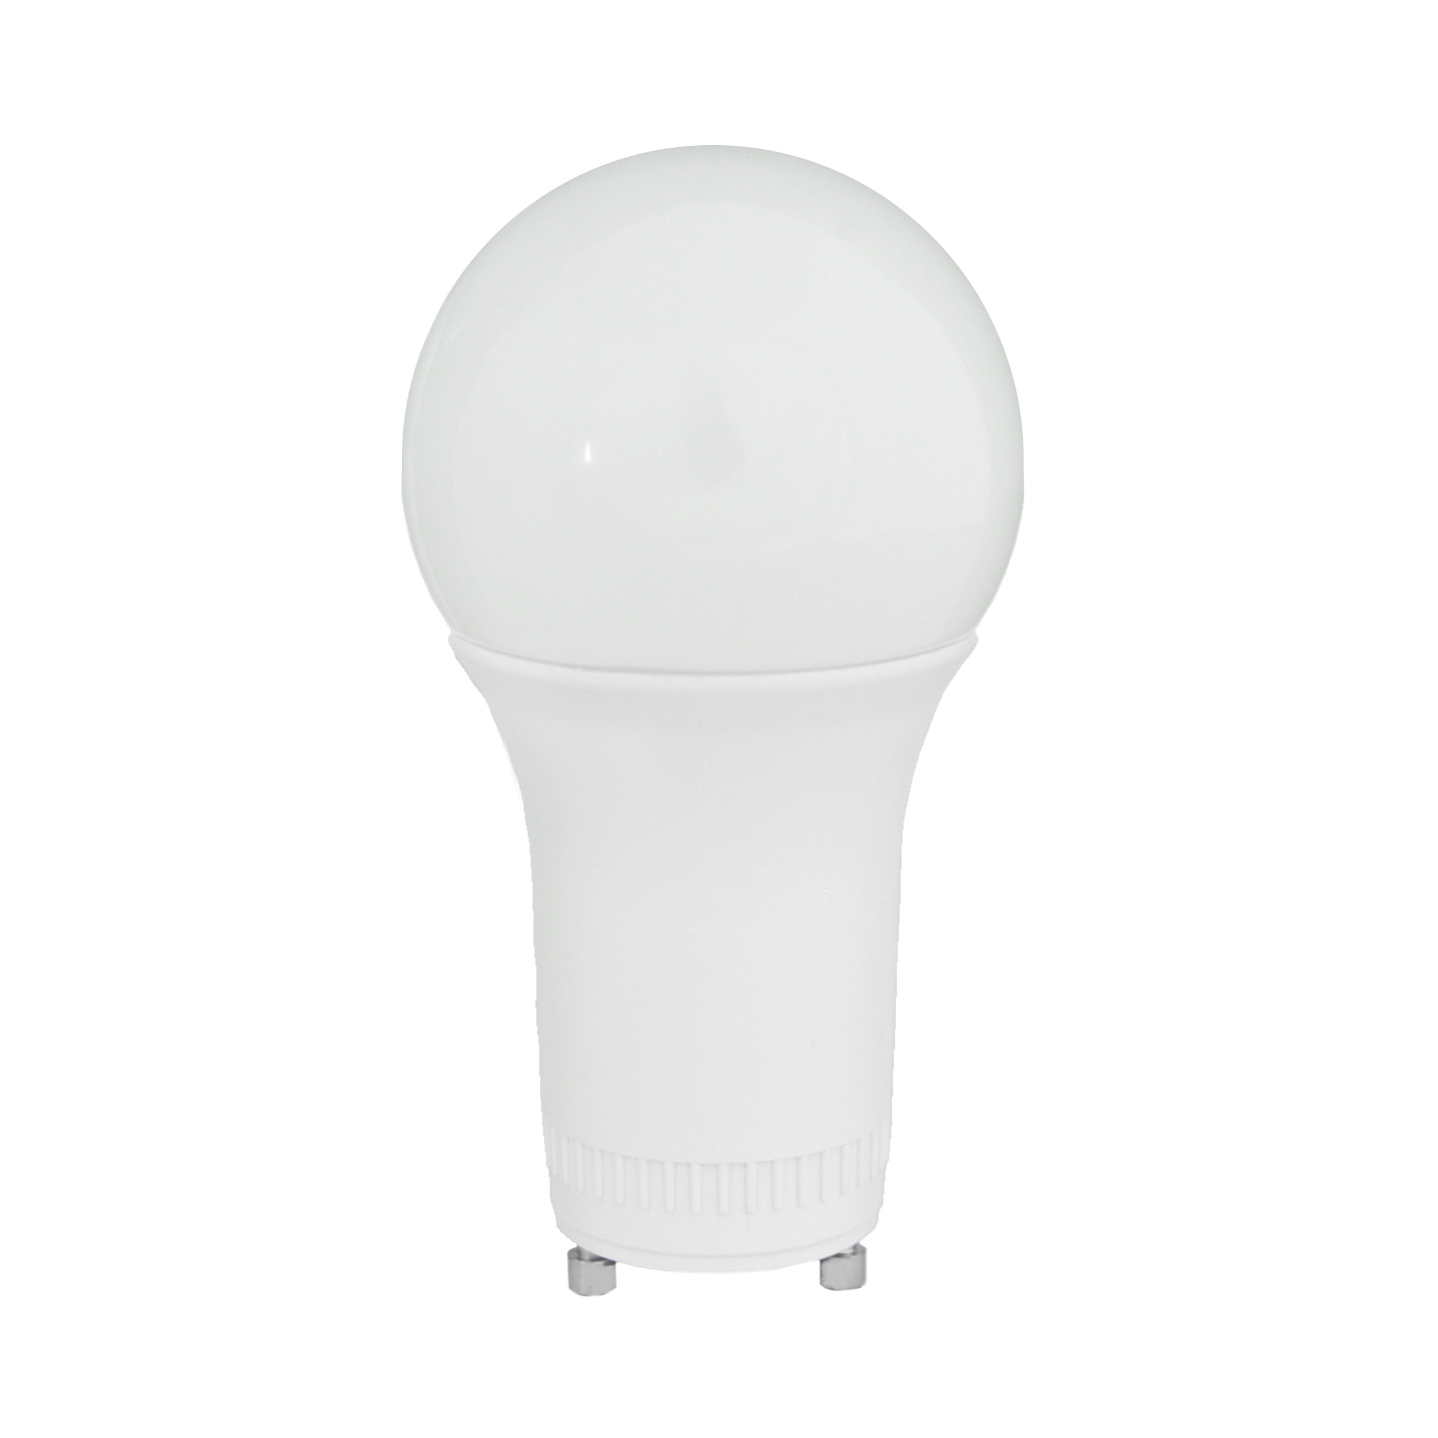
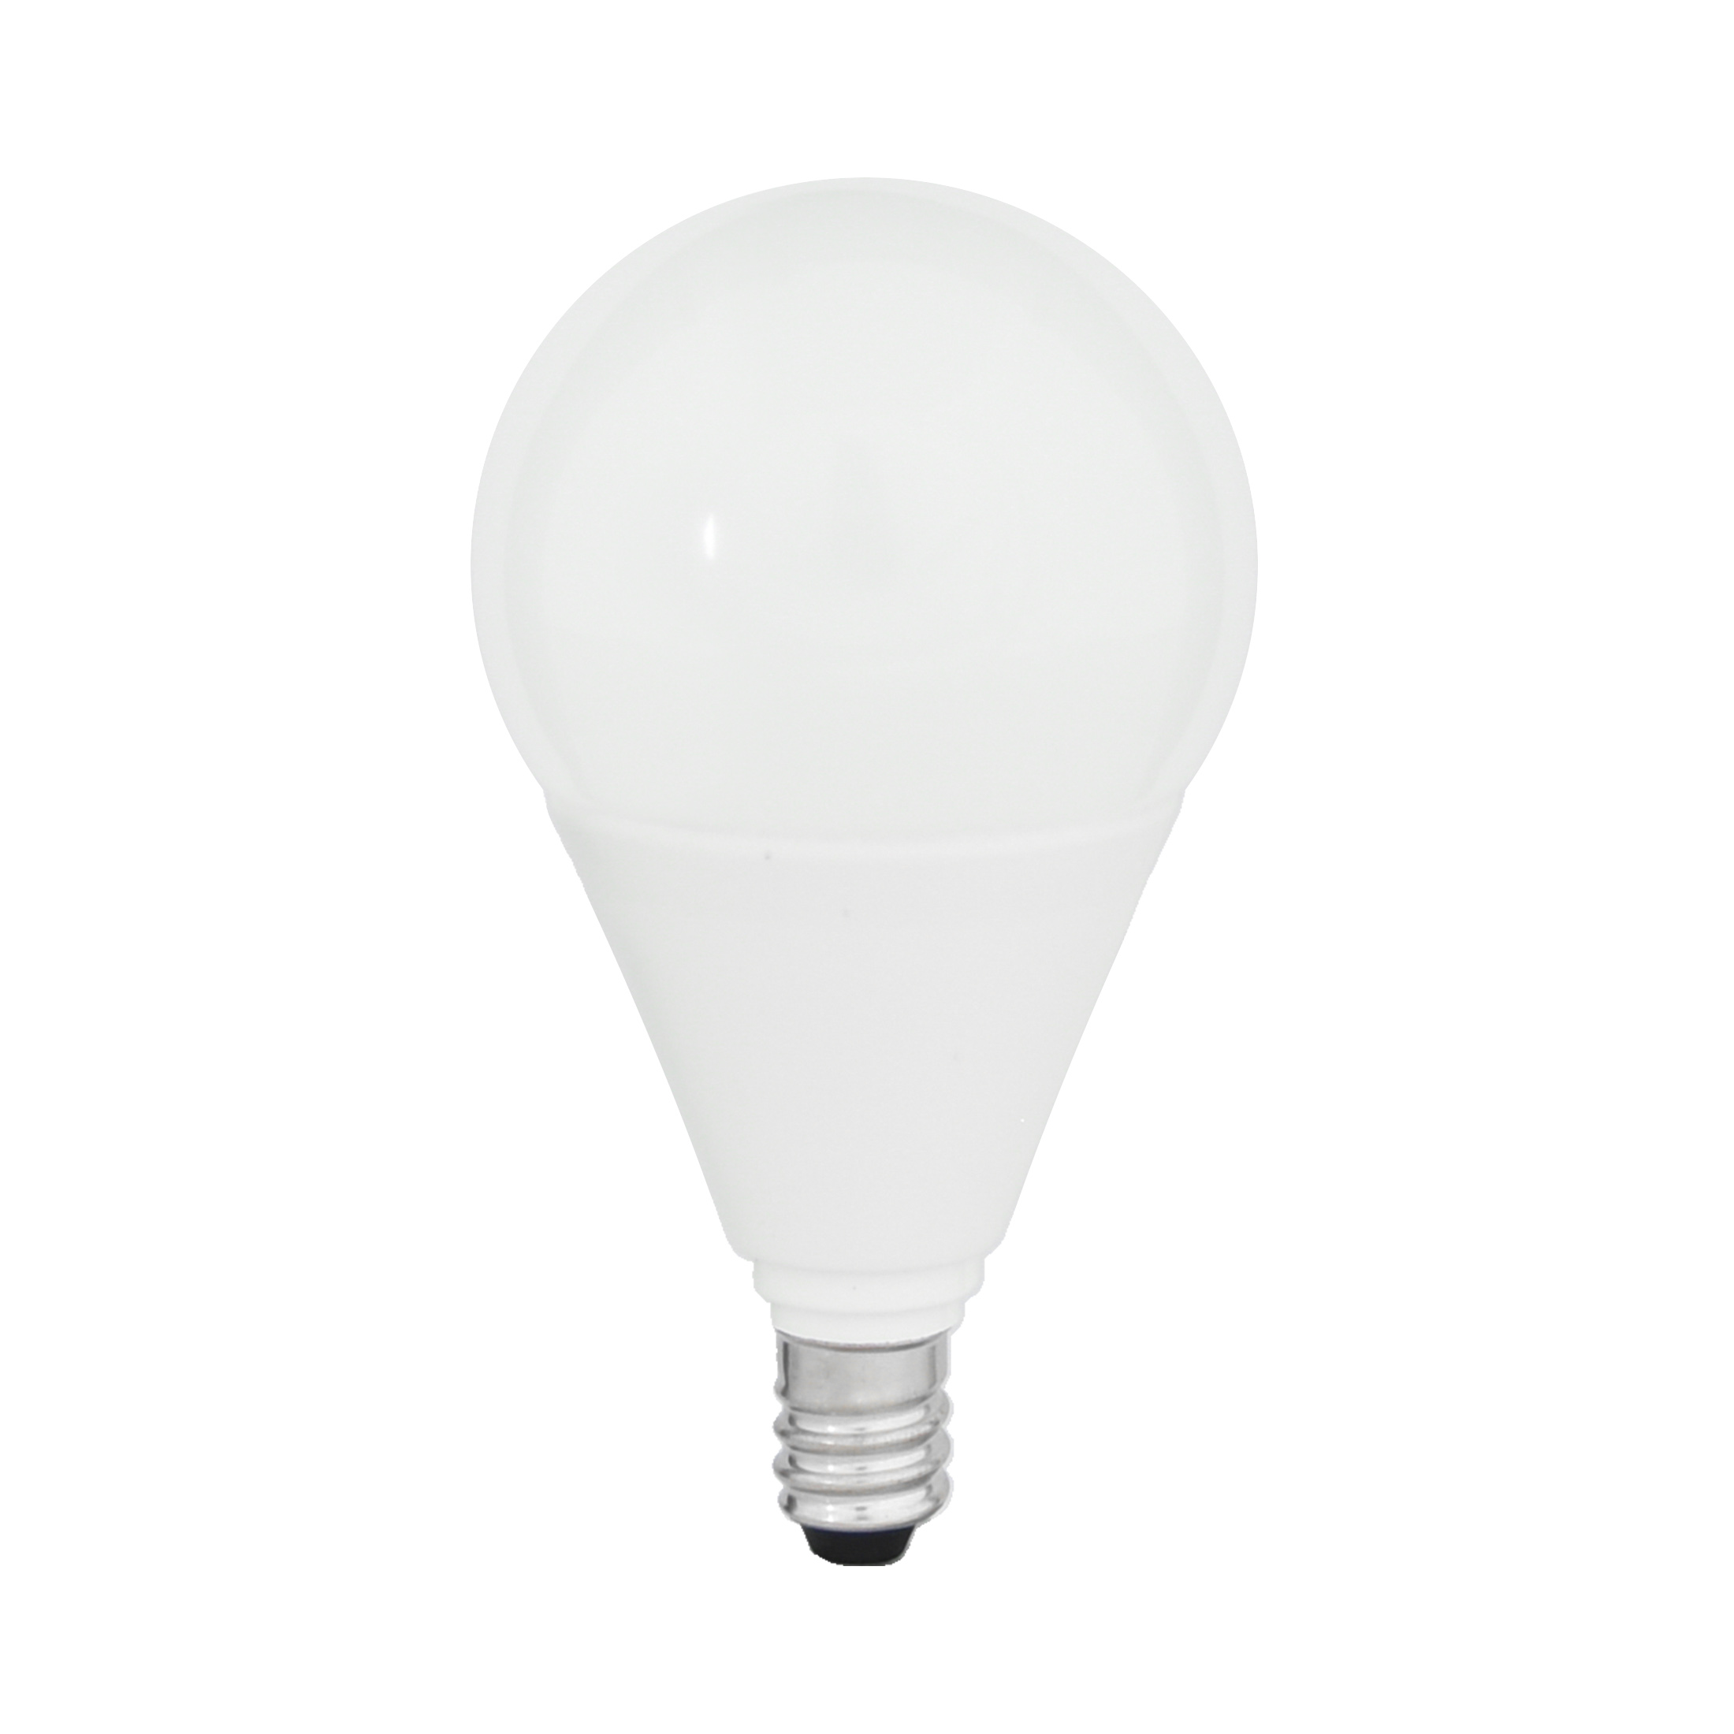
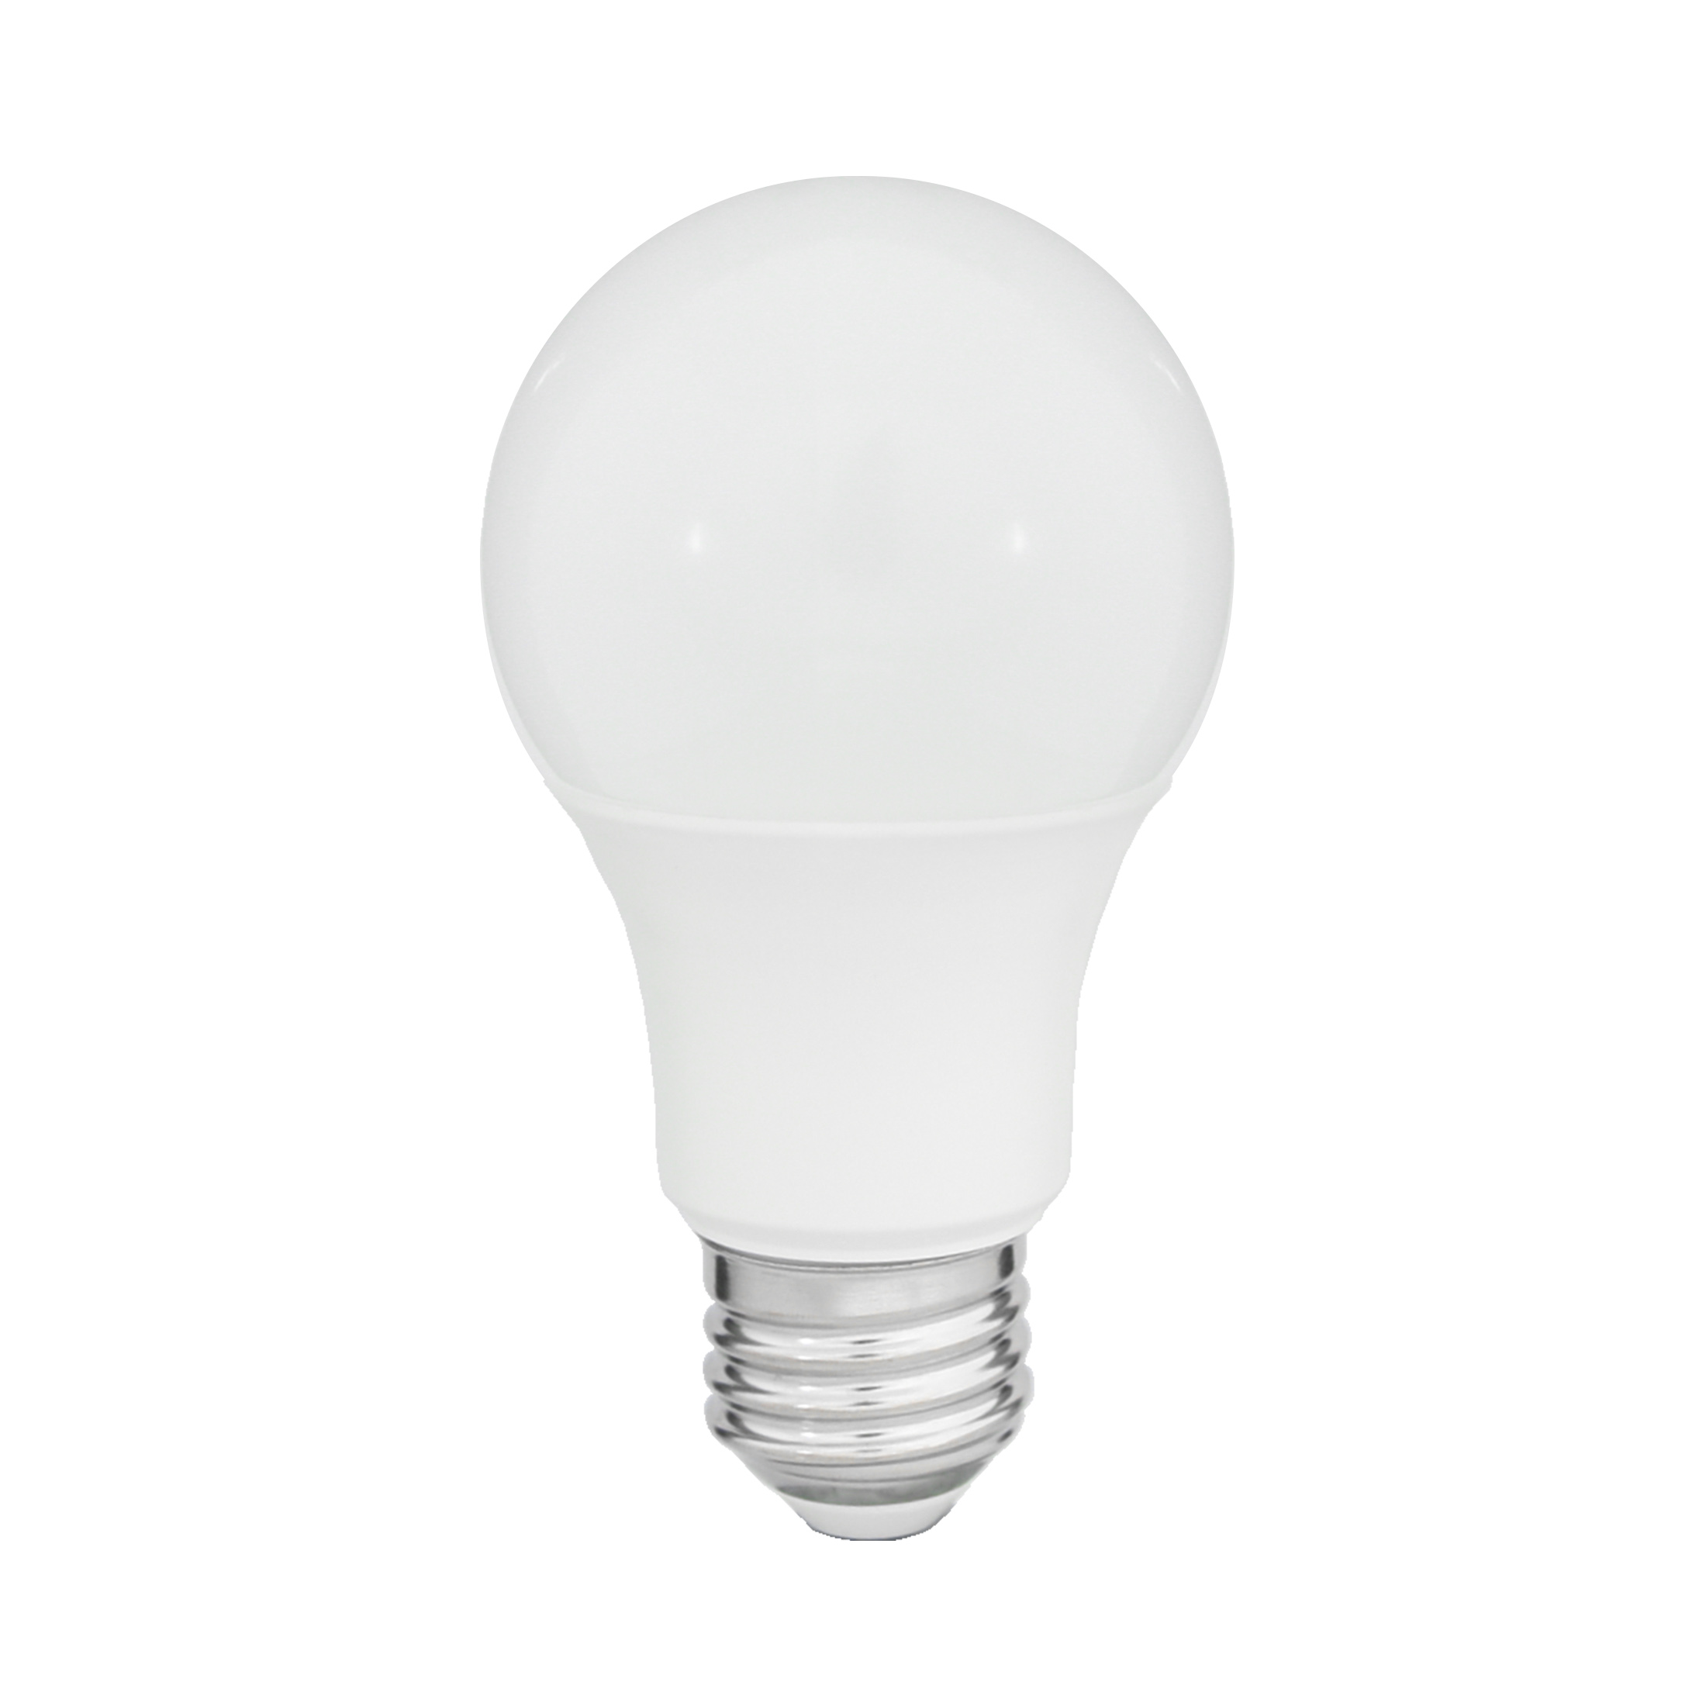
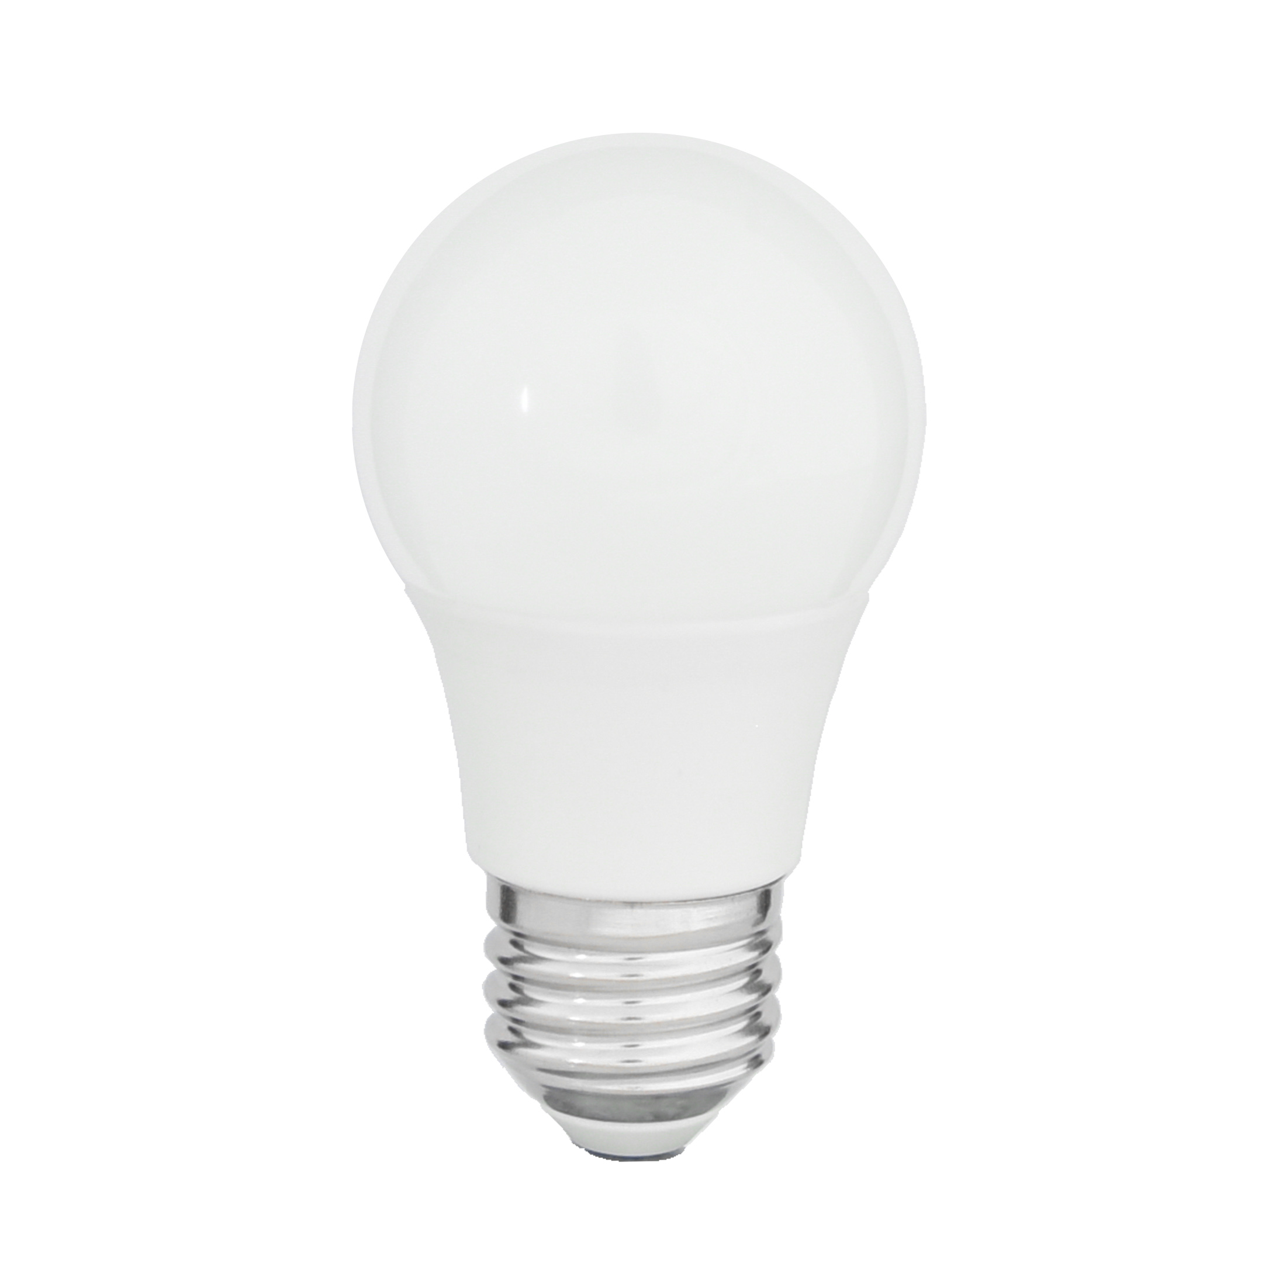
A LED LAMPS
A15 Glass
A15 Plastic
A19 Glass
A19 Plastic
120V
100-114 lm/W
-4°F to 104°F (-20°C to 40°C)
Fixed Wattage: 2.5, 4.5 7W Fixed CCT: 2700K
250 - 800 lumens
E26 Base
Triac Dimming down to 10%
Wet Location
120V
75-100 lm/W
-4°F to 104°F (-20°C to 40°C)
Fixed Wattage: 5.5, 6, 8W Fixed CCT: 3000K
450 – 800 lumens
E12, E17, E26 Base
Triac Dimming down to 10%
Damp Location
120V
94-103 lm/W
-4°F to 104°F (-20°C to 40°C)
Fixed Wattage: 4.5, 7, 8.5, 10,13W Fixed CCT: 2700, 3000, 4000K
450 - 1,600 lumens
E26
Triac Dimming down to 10%
Wet Location
120V
82-123 lm/W
-4°F to 104°F (-20°C to 40°C)
Fixed Wattage: 5.5, 8, 9, 11, 12, 13, 14, 15W Fixed CCT: 2700, 3000, 4000K
450 – 1,600 lumens
E26 and GU24 Base
Triac Dimming down to 10%
Damp Location
15,000 hours, replaces up to 60W Incandescent, Clear Glass
10,000 & 15,000 hours option, replaces up to 60W Incandescent, Frosted Shatter-resistant Polycarbonate
15,000 hours, replaces up to 100W Incandescent, Clear Glass
10,000 & 25,000 hours option, replaces up to 60W Incandescent, Damp Location, 90 CRI meets Title20/JA8, Frosted Shatter-resistant Polycarbonate

Slide 6
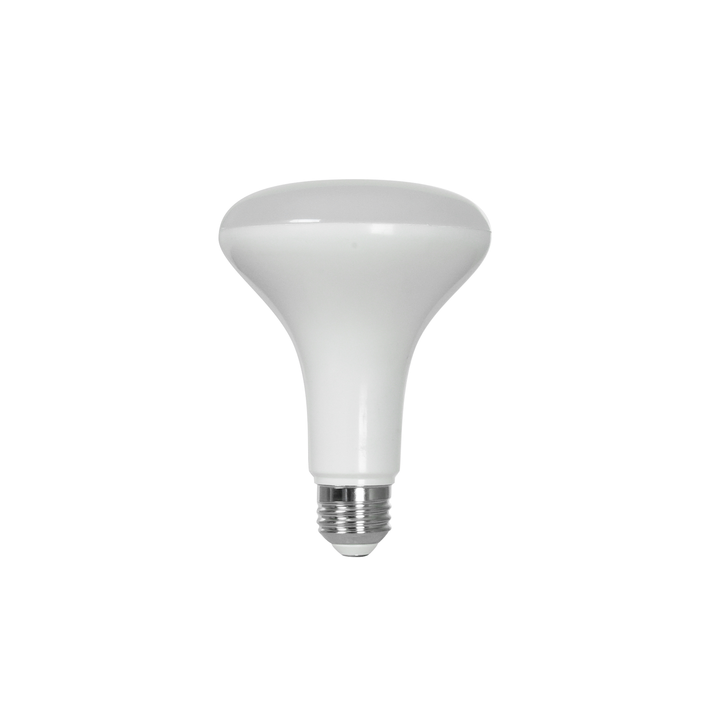
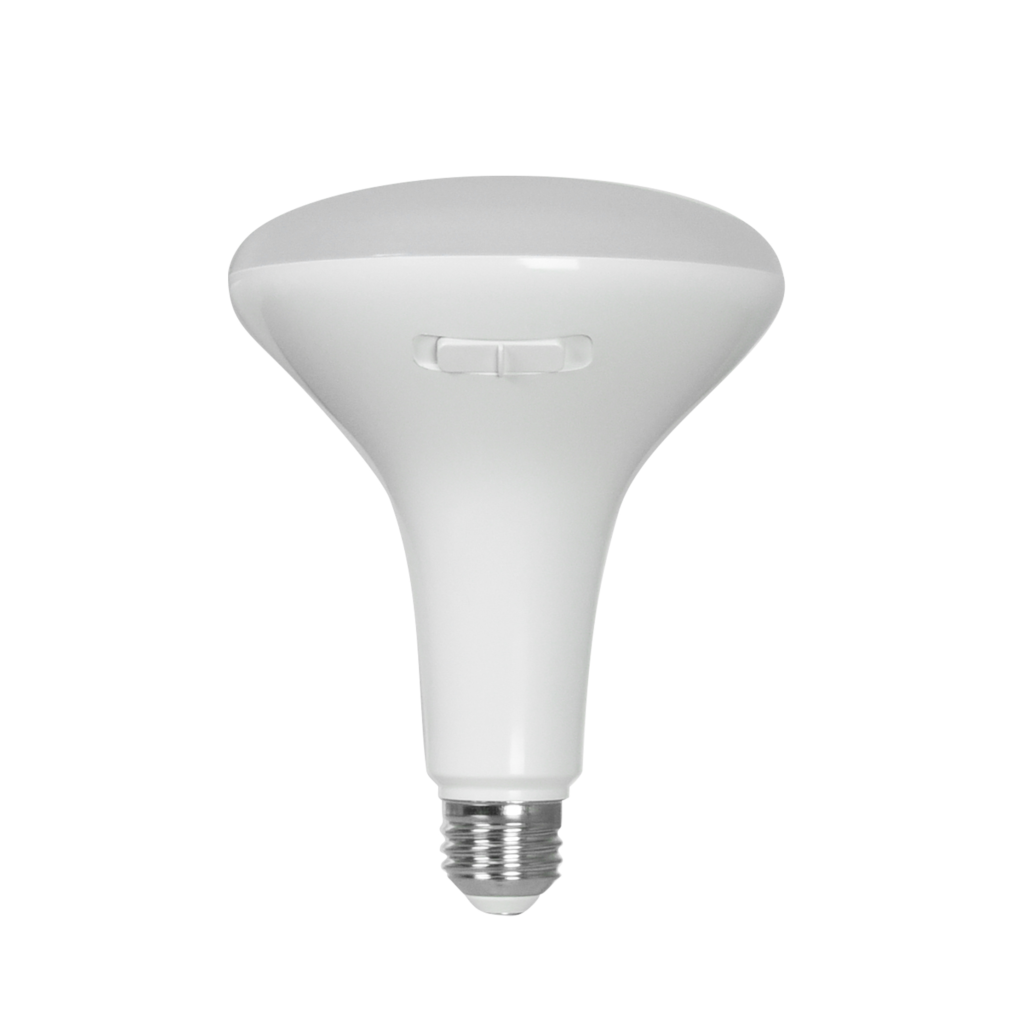
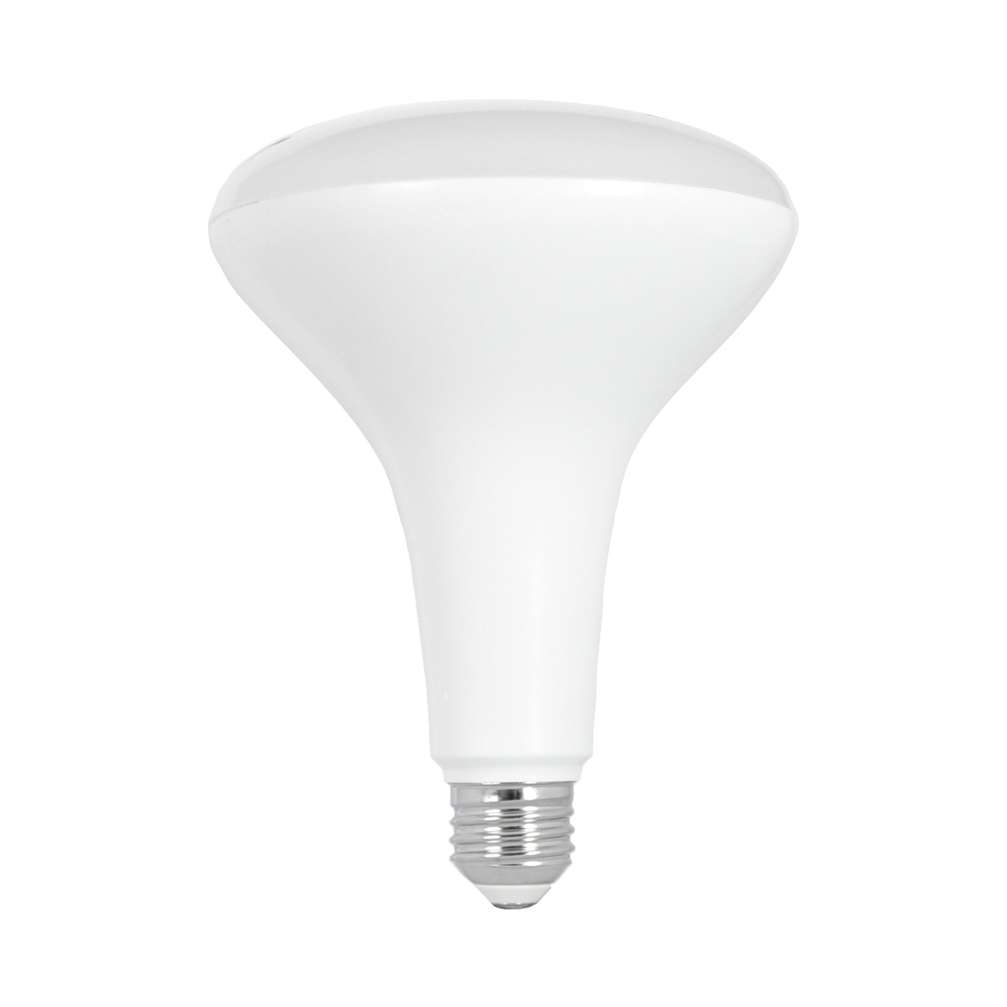
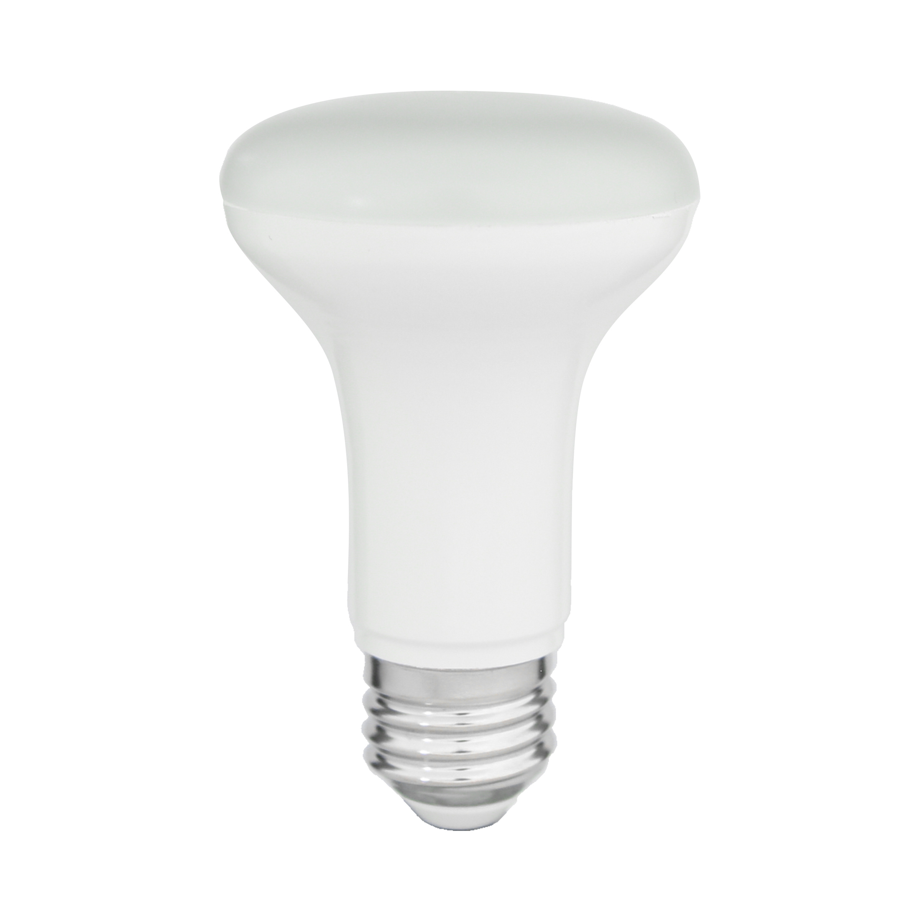
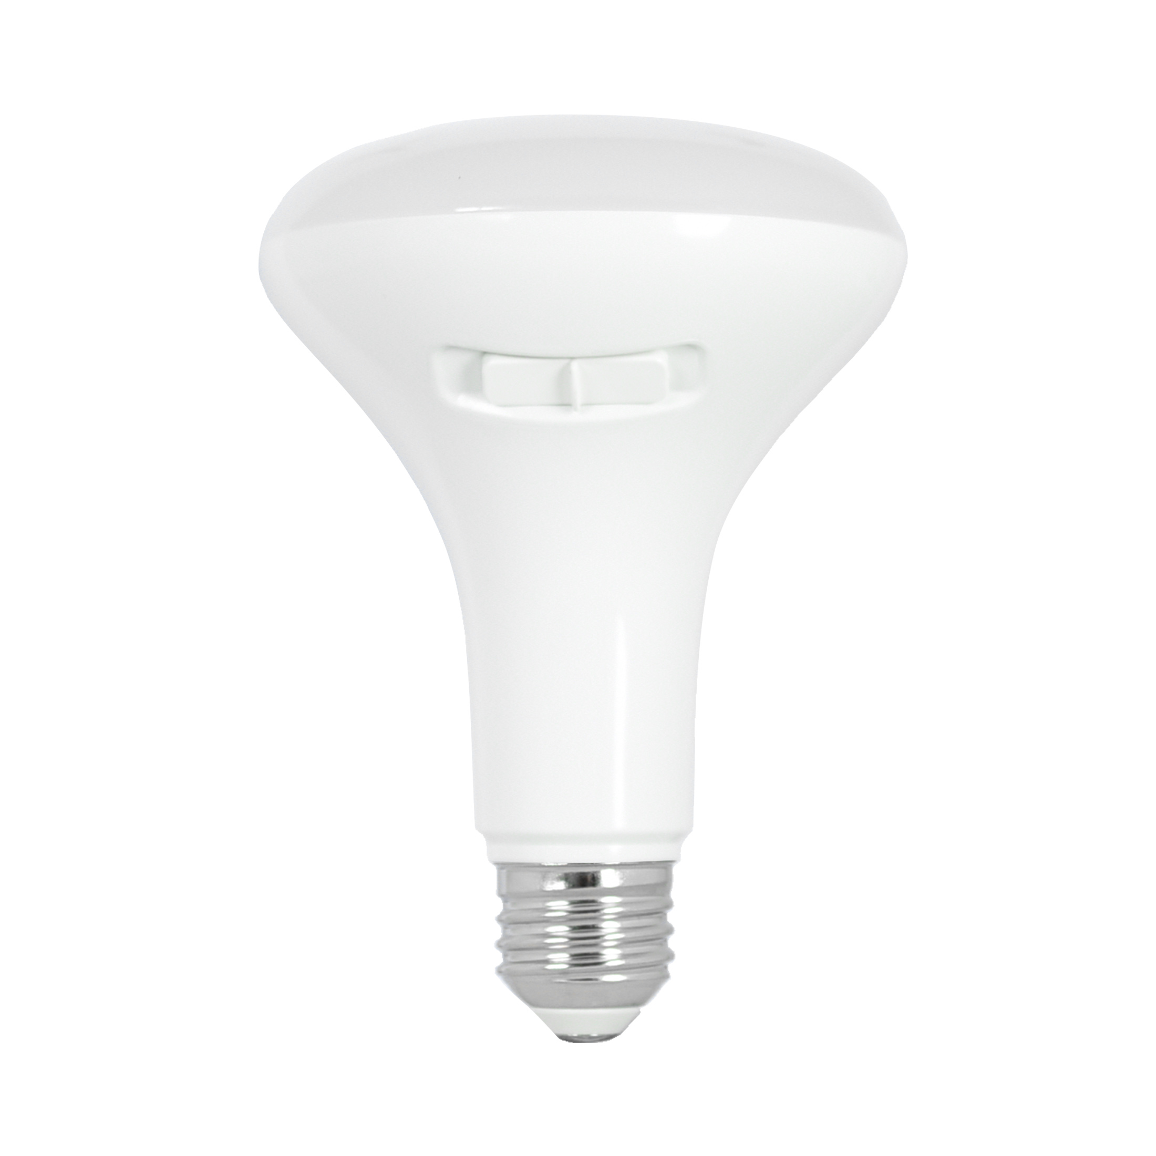
BR LED LAMPS
BR20
BR30
BR40
120V
78 lm/W
-4°F to 104°F (-20°C to 40°C)
Fixed Wattage: 7W Fixed CCT: 2700, 3000, 4000K
550 lumens
E26 Base
Polycarbonate lens
110°
Triac Dimming down to 10%
120V
81-100 lm/W
-4°F to 104°F (-20°C to 40°C)
Fixed Wattage: 7.5, 8, 10, 14W Fixed CCT: 2700, 3000, 4000K 80 CRI
Fixed Wattage: 7.5W FieldCCeT: 27/30/35/40, 5000K 90CRI
Up to 1,400 lumens
Polycarbonate lens
110°
Triac Dimming down to 10%
120V
82-90 lm/W
-4°F to 104°F (-20°C to 40°C)
Fixed Wattage: 7.5, 8, 10, 14W Fixed CCT: 2700, 3000, 4000K 80 CRI
Fixed Wattage: 12W FieldCCeT: 27/30/35/40/50K
Up to 1,400 lumens
Polycarbonate lens
110°
Triac Dimming down to 10%
25,000 hours, replaces 50W Incandescent
10,000 & 25,000 hour option, 80 and 90 CRI, 90 CRI meets Title 20/JA8, replaces 65 – 100W Incandescent
25,000 hours, 80 and 90 CRI, 90 CRI meets Title 20/JA8, replaces 75 – 100W Incandescent

Slide 7
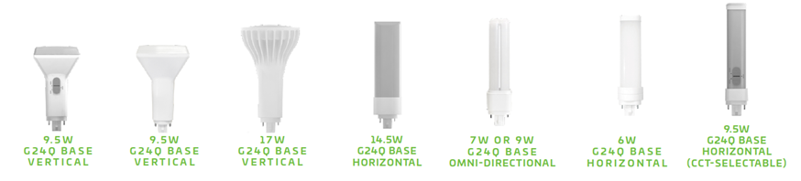
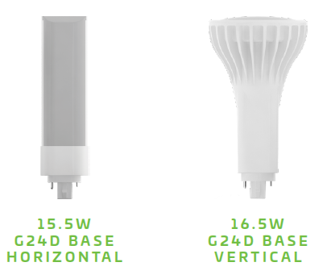
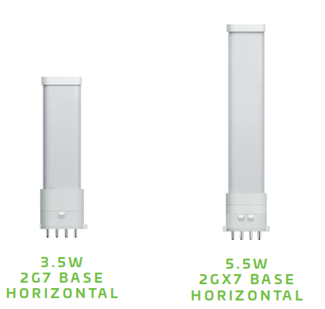
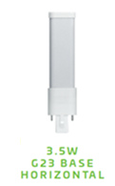
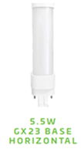
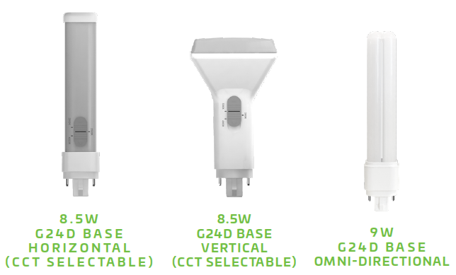
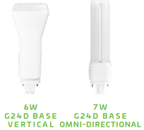
PL LAMPS
Type A
Type B
Type A+B
Voltage: Ballast Dependent
95-134 lm/W
-4°F to 113°F (-20°C to 45°C)
Fixed Wattage: 6, 7, 9.5, 14.5, 17W Fixed CCT: 3500, 4000K
Fixed Wattage: 9.5W FieldCCeT: 30, 35, 4000K
Up to 2,050 lumens
Damp location
120-277V
100-129 lm/W
-4°F to 113°F (-20°C to 45°C)
Fixed Wattage: 2G7: 3.5W, 2GX7: 5.5W, G24D: 15.5, 16.5W Fixed CCT: 2G7 & 2GX7: 2700, 4000K; G24D: 3500, 4000K
Up to 2,000 lumens
Damp location
120-277V
95-139 lm/W
-4°F to 113°F (-20°C to 45°C)
Fixed Wattage: G23: 3.5W, G24D: 6, 7, 8.5, 9W, GX23: 5.5W Fixed CCT: G23: 2700K; G24D: 3500, 4000K; GX23: 3000, 3500, 4000K
Fixed Wattage: G24D: 8.5W) FieldCCeT: G24D: 30/35/4000K
Up to 1,250 lumen
Damp Location
Lamp for lamp replacement, FieldCCeT and works on any of these bases G24q-1, G24q-2, G24q-3, GX24q-1, GX24q-2, GX24q-3, GX24q-4. Vertical, Horizontal and Omni Directional
No ballast required replaces existing G24d & GX24d (2-pin), G24q & GX24q (4-pin), Horizontal and Vertical
Two lamps in one! Lamp for Lamp replacement or wire directly to line voltage, all lamps work on 2 pin bases when used on 4 pins bases Type B install only. Vertical, Horizontal and Omni Directional

Slide 8
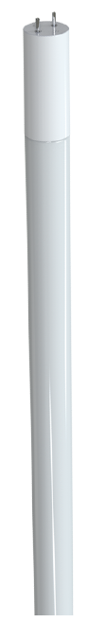
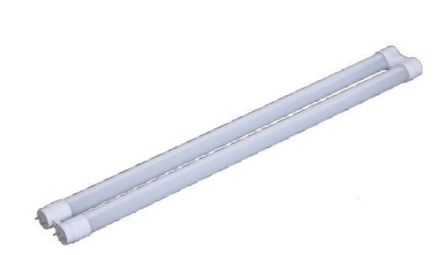
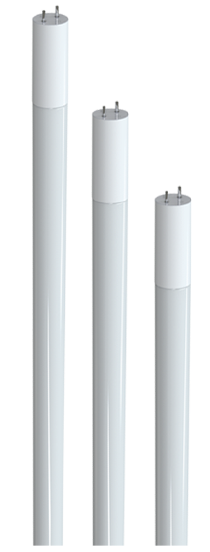
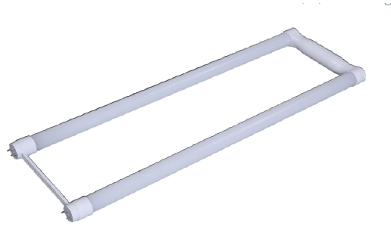
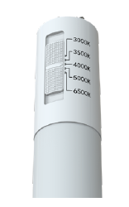
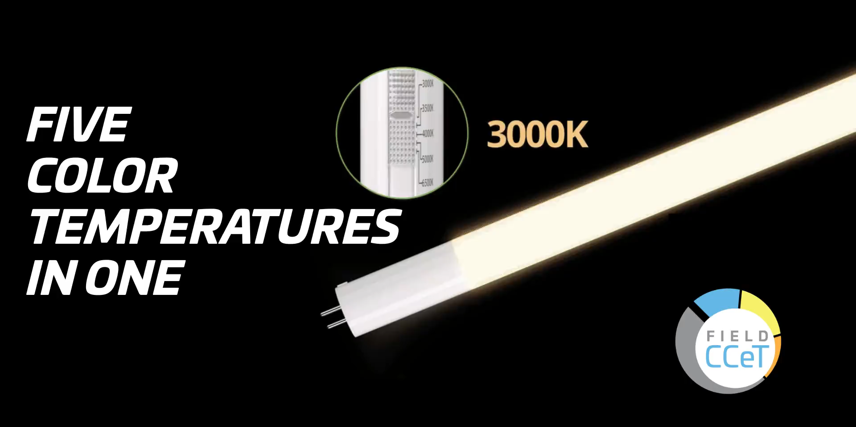
LINEAR GLASS TLED’S
Type A
Type B
Type A+B
2’, 3’, 4’
Voltage: Ballast Dependent
145-194 lm/W
-4°F to 113°F (-20°C to 45°C)
Fixed Wattage: 8, 8.5, 9.9, 11.5, 12.9W Fixed CCT: 3500, 4000, 5000K
Up to 2,200 lumens
Damp location
2’, 3’, 4’
120-277V
116-173 lm/W
-4°F to 113°F (-20°C to 45°C)
Fixed Wattage: 9, 9.5, 12, 14, 15W Fixed CCT: 3500, 4000, 5000K
Fixed Wattage: 9, 12, 14W FieldCCeT: 30, 35, 40, 50, 6500K
Up to 2,200 lumens
Damp location
x
4’
120-277V
140-150 lm/W
-4°F to 113°F (-20°C to 45°C)
Fixed Wattage: 12, 15W Fixed CCT: 3500, 4000, 5000K
Up to 2,200 lumens
Damp location
Lamp for Lamp Replacement, Wide range of Compatibility, 330˚ Illumination Angle, Uses shunted or Non-shunted sockets, Frosted Glass reduces Visual Glare & Optimal Heat Dissipation
No ballast required, Compatible with Emergency Batteries, FieldCCeT, 330˚ Illumination Angle, Frosted Glass reduces Visual Glare & Optimal Heat Dissipation
Two lamps in one! Lamp for Lamp replacement or wire directly to line voltage, Compatible with Emergency Batteries, 330˚ Illumination Angle,, Frosted Glass reduces Visual Glare & Optimal Heat Dissipation

Slide 9
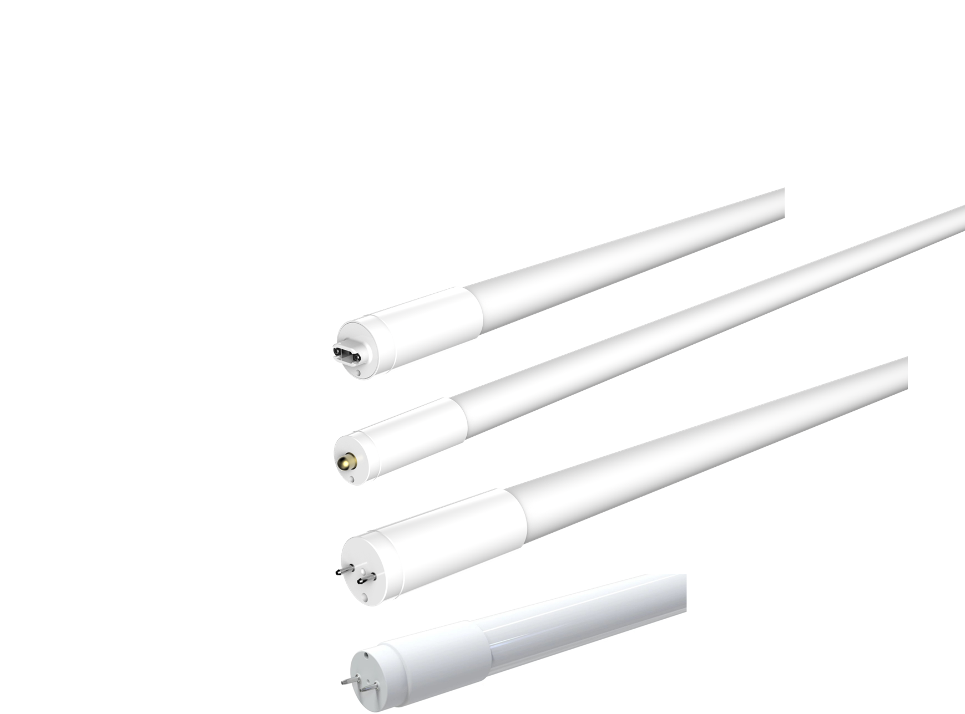
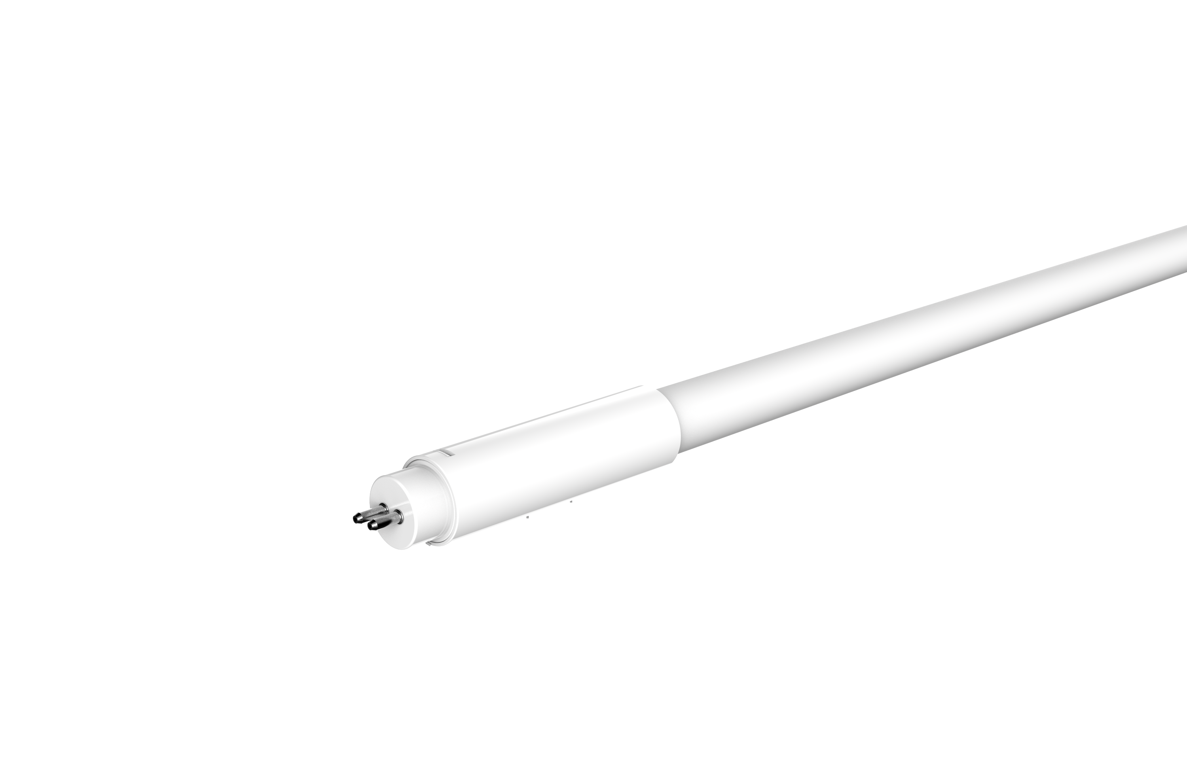
PLASTIC TLED’S
Type A T8
Type B T8
Type B T5
2’, 3’, 4’
Voltage: Ballast Dependent
Up to 171 lm/W
Fixed Wattage: 7; 8.5; 8.9; 13; 15.5W Fixed CCT: 4000, 5000K
Up to 2,500 lumens
2’, 3’, 4’, 8’
No ballast required!
Up to 161 lm/W
Fixed Wattage: 8; 9.5; 9.9; 14.5; 23.5; 36.5W Fixed CCT: 4000, 5000K
Up to 5,500 lumens
2’, 3’, 4’
No ballast required!
Up to 152 lm/W
Fixed Wattage: 7; 10; 14; 23W 23 Fixed CCT: 3000, 4000, 5000K
Up to 3,500 lumens
External emergency battery backup
NSF Rated; Polycarbonate material that offers durability and reduced breakage. Functions on most electronic T8 ballast (instant & programmed) and battery backups
NSF Rate; Polycarbonate material that offers durability and reduced breakage. Works on shunted or non-shunted sockets, for applicable single or double-ended applications. F8A, G13, R17D
NSF Rate; Polycarbonate material that offers durability and reduced breakage.

Slide 10
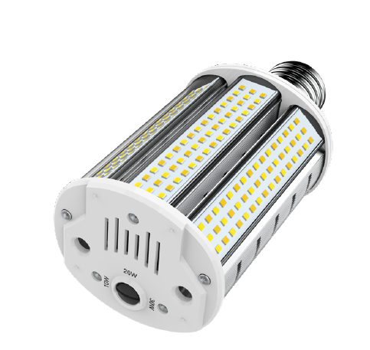
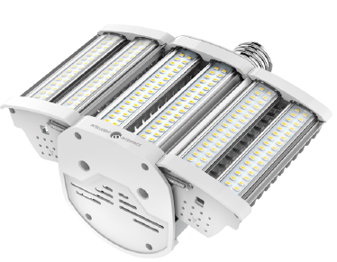


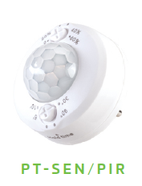
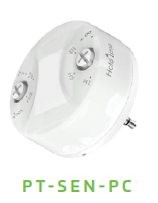
HID LED REPLACEMENT LAMPS
AREA LIGHT
WALLPACK
120-277
Up to 150 lm/W
Fixed Wattage: 80, 110W Fixed CCT: 3000, 4000, 5000K
Up to 16,500 lumens
Plug-In
EX39
120-277V
144-162 lm/W
PowerSet: 20/10/5W; 30/20/10W; 40/30/20W; 60/40/20W FieldCCeT: 30/40/5000K
Up to 9,000 lumens
E26 and EX39
180° beam angle, Horizontal Operation,
Expands to Illuminate Wider Area, Controls Ready, Replaces up to 400W HID
Small Compact Size, Horizontal Mount, Rotatable Base, 4kV Surge Protection, Replaces up to 250W HID

Slide 11
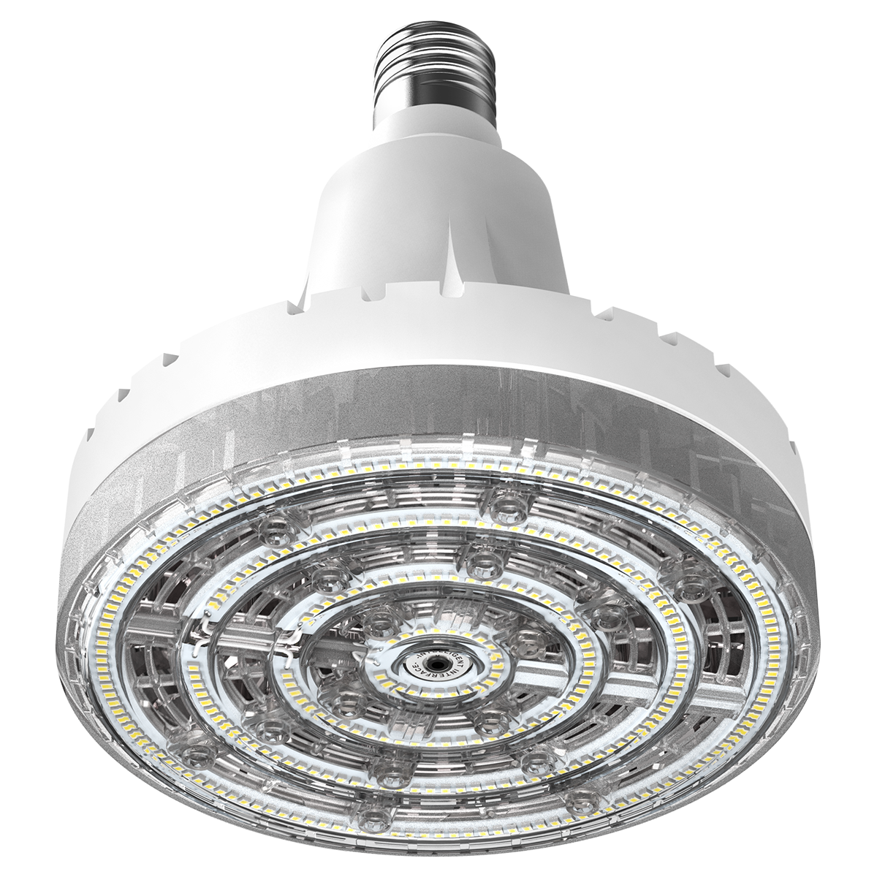
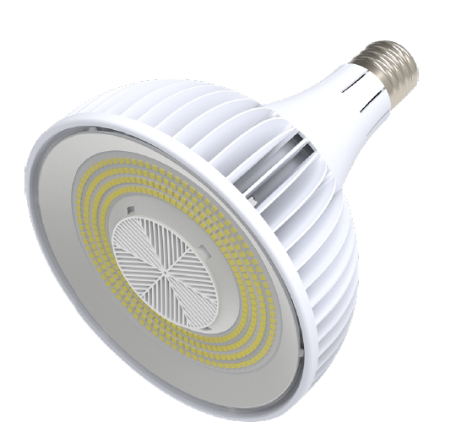
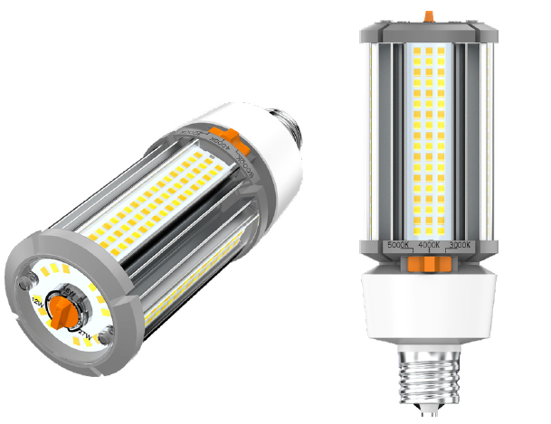
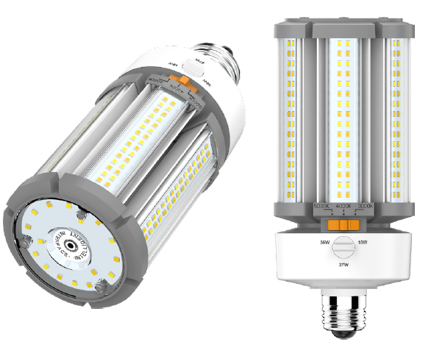
HID LED REPLACEMENT LAMPS
HIGH/LOW BAY
HIGH/LOW BAY
CORN COB
CORN COB – 480V
120-277
Up to 164 lm/W
Fixed Wattage: 72, 100, 152W Fixed CCT: 4000, 5000K
Up to 25,000 lumens
E39
120-277V
Up to 135 lm/W
Fixed Wattage: 80, 115W Fixed CCT: 3000, 4000, 5000K
Up to 15,500 lumens
EX39
120-277V
123-151 lm/W
PowerSet: E26 & EX39: 18/12/9W; 27/18/12W; 36/27/18W; 54/45/36W EX39: 63/54/45W; 80/63/54W; 100/80/63; 120/100/80W FieldCCeT: 30/40/5000K
Up to 17,400 lumens
E26 and EX39 Base
277-480V
116-137 lm/W
Fixed Wattage: E26 & EX39: 36, 45, 54W EX39: 80, 100W FieldCCeT: 30/40/5000K
Up to 14,000 lumens
EX26 and EX39 Base
6kV surge protection, Ballast Bypass, Replaces up to 400W HID
Controls Ready, Ballast Bypass, Replaces up to 400W HID
Vertical and Universal Mount, Controls Ready, Replaces up to 320W HID
Vertical and Universal Mount, 277- 480V, Replaces up to 250W HID

Slide 12
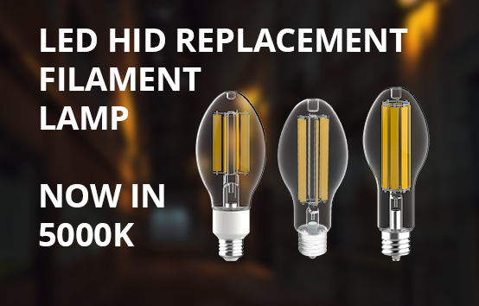
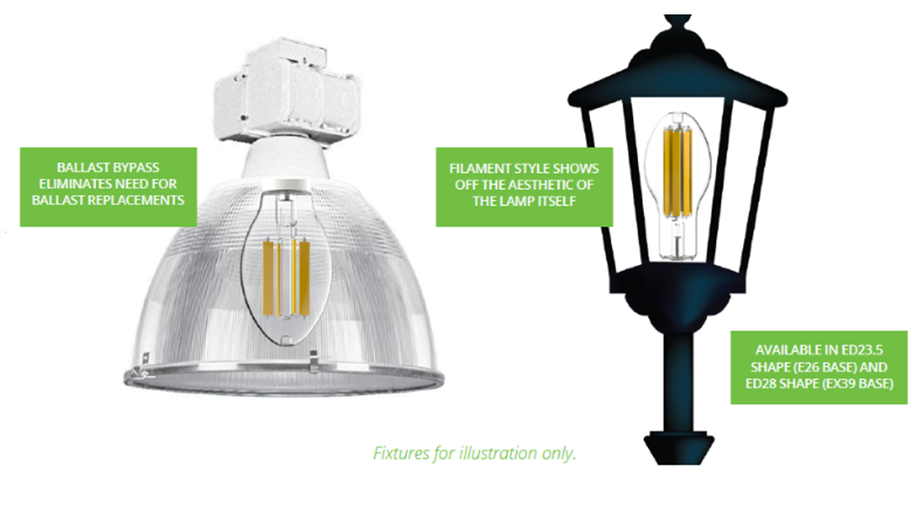





HID LED REPLACEMENT: LED FILAMENT
LED HID REPLACEMENT
Ballast bypass eliminates need for ballast replacement
Filament style shows off the aesthetic of the lamp
Available in EX39 and E26 Base
167 lm/W
120-277V
-40°F to 113°F (-40°C to 45°C) ambient operating temperature
Fixed Wattage: 28, 36, 45W Fixed CCT: 3000, 4000, 5000K
4,000 to 7,500 lumens
T2
T3
T4
T5
Notes:
These are great for post tops, low bays, bollards and any application where you want to show off the aesthetics of the lamp. (press enter) Since these are a Type B lamp they do operate on 120-277V. They come in at a whomping 167 lm/W. Wattage options are 28, 36, and 45W, Lumens range from 4000 to 7,500. Fixed CCT of either 3000 or 4000K.
(press enter) Key features are that it fits in many traditional HID fixtures since it’s offered in both ED23.5 and ED28 shape, it also gives you that same look of a traditional HID and since it’s ballast Bypass you no longer have to worry about maintaining the ballast.
(press enter) It also has 4 kV surge protection included, these are Not suitable for use with dimmers, it’s provides Omni directional light output, Universal Installation Position, It’s Slightly smaller than traditional HID lamps, -40°F to 113°F (-20°C to 45°C) ambient operating temperature. Not recommended for air-tight fixtures
(press enter) certifications include UL Listed for US and Canada, FCC, ROHS, ICES-005 Compliant, damp location rated for E26 bases and Wet location for EX39 bases. 3 year warranty.
Competition:

Slide 13
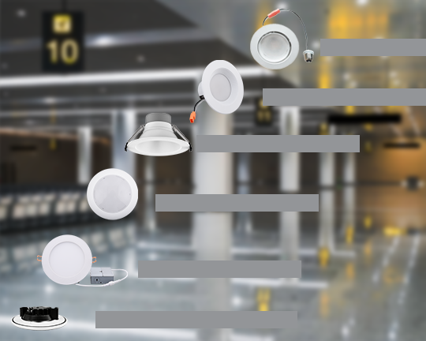
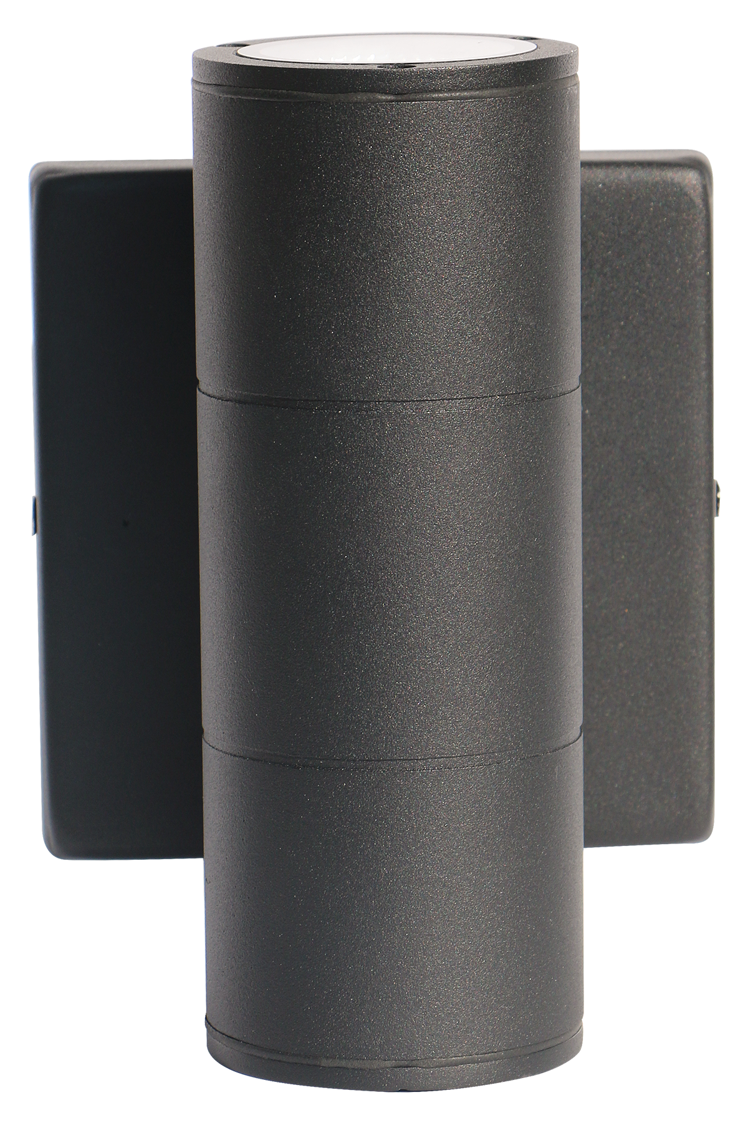











DOWNLIGHTS
Retrofit Made Easy - RDR
Direct the Light- DRTR
Decorative
Direct the Light
Wattage |  | 4": 8 & 10 & 13 6": 11, 13, 16 & 17
Lumens |  | 4”: 650 – 1040 6”: 750 – 1,500
 |  | 6”: 750 – 1,500
Wattage |  | 4": 10 & 12 6": 11 & 13
Lumens |  | 4": 750-800
 |  | 6": 880-900
Retrofit Made Easy
Effortless Design
Easily Fits into a J-Box
Magnetic Trim – DS4
Decorative– Westport
Canless Design
Wattage |  | 4": 8
Lumens |  | 4”: 600 - 700
Wattage |  | 6”: 30
Lumens |  | 6”: 3,000
Magnetic Trim
Effortless Design - CD
Easily Fits into a J-Box - DSD
Canless Design - DWR
Wattage |  | 4": 6/8/12 6": 8/12/16 & 20/26/33 8": 12/16/22 10": 22/26/33
Lumens |  | 4”: 540 – 1,140 6” : 760 – 1,525 6”: high lumen 2,400-4,000 8” : 1,280 – 2,125 10”: 2,125 – 3,140
 |  | 6” : 760 – 1,525 & 2,400-4,000
 |  | 8” : 1,280 – 2,125
 |  | 10”: 2,125 – 3,140
Wattage |  | 4": 10 6": 13 8": 15
Lumens |  | 4”: 700 & 830 6”: 1,000 8”: 1,200
 |  | 6”: 1,000
 |  | 8”: 1,200
Wattage |  | 4": 13 6": 16 8": 20
Lumens |  | 4”: 800 6”: 1,200 8": 1,600
 |  | 6”: 1,200
 |  | 8": 1,600

Slide 14







DECORATIVE
AGES Flush Mount
ODYSSEY Flush Mount
BRV Bulb Ready Vanity
VAN Lenexa Vanity
12, 14, 16”
Triac Dimming
Up to 75 lm/W
120V
Fixed Wattage: 16, 20W Fixed CCT: 3000K
Fixed Wattage: 16, 20, 24W FieldCCeT: 27/30/35/40/5000K
1,200 - 1,800 lumens
Damp Location
11” & 14”
Triac Dimming
Up to 75 lm/W
120V
Fixed Wattage: 16, 25W Fixed CCT: 3000K
1,200 & 1,875 lumens
Damp Location
14” (2 head), 20” (3 head), 27” (4 head)
Dimmable based on lamp
Up to 60 W Incandescent or 9W LED Lamp
480 – 800 lumens
Damp Location
LED not integrated
2’, 3’, 4’
Triac or 0-10V Dimmable
Up to 75 lm/W
120V
Fixed Wattage: 28, 40, 55W Fixed CCT: 3000K 80 CRI
Fixed Wattage: 28, 40, 56W FieldCCeT: 27/30/4000K 90 CRI
2,100 – 4,000 lumens
Damp Location
Silver Finish, light weight, easy install, polycarbonate lens, 80 CRI
Light weight, shatter-resistant construction, easy install, Frosted Lens, 80 CRI
Customizable based on style, finish, number of heads and lamp choice, Bronze or Nickel Finish
Nickel finish, steel body, polycarbonate lens, 80 and 90 CRI options, FieldCCeT
Notes:
Last month Daniel introduced us to the new BRV – Bulb ready vanity and Lenexa Vanity. Both of these are a really nice addition to the flush mount Ages and Odyssey
These are all very easy to install, all instant on, all damp location and dim via a standard triac dimmer assuming you use dimmable lamps with the bulb ready vanity, the Lenexa also features a 0-10V dimmable driver. They are all available in a couple of different sizes and wattage outputs and are ideal for a number of applications like hallways, bathrooms, hotels and motels, dorm rooms and many other areas
Just remember, these do not need to be used just in bathrooms they can be a decorative fixture for general lighting.
The AGES and Lenexa both feature a FieldCCeT option.

Slide 15




PANELS
BP1
EP1
EP1
EDGELIT FLAT PANEL
Super Slim Design
4 Knockouts
6” J-Box
3 SKU’s to accommodate Networked Lighting Controls
1x4, 2x2, 2x4
0-10V Dimming
Up to 125 lm/W
120-277V; 120-347V
EM option
Aircraft, recessed, surface mount
Fixed Wattage: 30, 40W Fixed CCT: 4000K
PowerSet: 30/25/20W; 40/30/25W; 50/40/30W Fixed CCT: 4000K
PowerSet: 30/25/20W; 40/30/25W; 50/40/30W FieldCCeT: 35/40/5000K
Up to 6,250 lumens
1x4, 2x2, 2x4
0-10V Dimming
Up to 125 lm/W
100-277V
PowerSet: 30/25/20W; 50/40/30W FieldCCeT: 35/40/5000K
Up to 6,250 lumens
EM option
Aircraft, recessed, surface mount
Notes:
These are both excellent fixtures for parking garages but can certainly be used in tunnels, canopies, building entrances and food facilities.
Xi-Fi is embedded into both of these fixtures giving you that motion sensor, daylight sensor and the ability to adjust bright levels and create zones or groups of fixtures.
They are both offered in a couple of different wattages. The phaeton comes in at 135 Lumens per watt and the Poseidon comes in at 157.
You will also noticed that the Poseidon is BAA and Assembled in the UA.
SCRG: UL Listed for wet Locations
IP65 Rated
DLC Premium
-40F to 104F operating temperature
Optional integrated microwave motion and photo sensor
SCS Surface
10” x 10” x 2.8”
Rebate friendly
PowerSet advantages:
SKU reduction for stocking distributors
More flexibility on the job site
High end trim
Standard Z10 receptacle simplifies controls
Easy one person installation
SCS – optional garage distribution – gets light further out,, canopy distribution with optional garage distribution. Look at spec sheet.

Slide 16



TROFFER AND TROFFER RETROFIT
VL1
VLR1
1x4, 2x2, 2x4
0-10V Dimming
Up to 140 lm/W
120-277V; 120-347V
PowerSet: 35/30/22W, 45/35/26W; 90/75/65W FieldCCeT: 35/40/5000K
Up to 12,600 lumens
Recessed, surface or suspended mount
1x4, 2x2, 2x4
0-10V Dimming
Up to 140 lm/W
120-277V; 120-347V
PowerSet: 35/30/22W; 45/35/26W; 90/75/65W FieldCCeT: 35/40/5000K
Up to 12,600 lumens
8, 15, 20W EM Field or Factory Installed
5 Piece design – 2 support brackets and 2 optional side plates
Notes:
These are both excellent fixtures for parking garages but can certainly be used in tunnels, canopies, building entrances and food facilities.
Xi-Fi is embedded into both of these fixtures giving you that motion sensor, daylight sensor and the ability to adjust bright levels and create zones or groups of fixtures.
They are both offered in a couple of different wattages. The phaeton comes in at 135 Lumens per watt and the Poseidon comes in at 157.
You will also noticed that the Poseidon is BAA and Assembled in the UA.
SCRG: UL Listed for wet Locations
IP65 Rated
DLC Premium
-40F to 104F operating temperature
Optional integrated microwave motion and photo sensor
SCS Surface
10” x 10” x 2.8”
Rebate friendly
PowerSet advantages:
SKU reduction for stocking distributors
More flexibility on the job site
High end trim
Standard Z10 receptacle simplifies controls
Easy one person installation
SCS – optional garage distribution – gets light further out,, canopy distribution with optional garage distribution. Look at spec sheet.

Slide 17



WRAPS
LLW
LW
2’ & 4’
0-10V Dimmable
115 lm/W
120-277V & 120-347V
Fixed Wattage 4’: 32, 40, 48W Fixed CCT 4’: 4000K
Fixed Wattage 2’: 20W 4’: 32, 40, 48W FieldCCeT 2’ & 4’: 35/40/5000K
  PowerSet 2’: 24/20/16W; 4’: 28/40/32W FieldCCeT: 35/40/5000K
  Up to 5,520 lumens
2’ & 4’
0-10V Dimmable
115 lm/W
120-347V
Fixed Wattage 2’: 25W 4’: 44W Fixed CCT 4’ only: 4000K
Fixed Wattage 2’: 20W 4’: 32, 40, 48W FieldCCeT 2’ & 4’: 35/40/5000K
  PowerSet 2’: 15/20/25W; 4’: 27/36/45W FieldCCeT 2’ & 4”: 35/40/5000K
Up to 5,175 lumens
Modern Look, Diffused Lens, Decorative End Caps, Internal Back-up Battery Field Installed
Center Basket
12V DC Auxiliary output included as standard, ½ KOs on either end instead of linking connectors, EM Battery Field Installed (PowerSet/FieldCCeT version)

Slide 18




STRIPS
CSX1
CST1
2’, 4’, 8’
0-10V Dimming, Dim-to-off
Up to 130 lm/W
120-277V or 120-347V
PowerSet: 2’: 25/20/15W; 4’: 45/35/26W; 65/60/55W; 8”: 90/75/65W FieldCCeT: 4’ & 8’: 4000K, 5000K
PowerSet: 4’: 45/35/26W; 65/60/55W; 8”: 90/75/65W FieldCCeT: 35/40/5000K
  Up to 11,700 lumens
  8, 15 & 20W EM field or factory installed
4’, 8’
0-10V Dimming, Dim-to-off
Up to 130 lm/W
120-277V
Fixed Wattage: 4’:32W 8’: 64W Fixed CCT: 4000, 5000K
  Up to 8,320 lumens
  EM field installed
  V-hooks & j-box cover plate included
Notes:
Our Volumetric troffer is our go to troffer. As you can see by the specifications the standard troffer and the retrofit fixture are both very similar; however, the retrofit fixture is ideal for areas where the end user doesn’t want to remove the existing troffer as that can be costly. Instead, this retrofit can easily be installed utilizing the existing housing of 1X4, 2X2 or 2X4 fixtures.
To install you simply remove the lens, lamps, tombstones, and ballast in the existing fixture and then install this retrofit door housing kit. This can save in install and disposal costs as this door housing kit accelerates install time and greatly reduces waste and clean up.
Both of these fixtures also feature PowerSet and FieldCCet,
(PRESS ENTER) For the new fixture there is a PowerSet version with 3 set and forget lumen stops so you would order that fixture in a static color and have the ability to change lumen output and the second option is for both PowerSet and FieldCCeT so 3 lumen stops and 3 color stops. The same is true for the Retrofit except instead of having 3 lumen or wattage choices you get 4.
Press enter. In those situations where you need to meet buy American act or assembled in America we also have our Rhodium troffer.

Slide 19



STRIPS
STR
STR-R
LS3
2’, 4’, 8’
0-10V Dimming
Up to 131 lm/W
100-277V
PowerSet: 2’: 24/20/16W 4’: 45/38/34W 8’: 90/75/65W Fixed CCT: 3500, 4000, 5000K
PowerSet: 2’: 24/20/16W 4’: 45/38/34W 8’: 90/75/65W FieldCCeT: 35/40/5000K
Up to 11,800 lumens
4’, 8’
0-10V Dimming
Up to 130 lm/W
120-277V; 120-347V
PowerSet: 4’: 44/35/27/22; 8’: 88/68/54W Fixed CCT: 3500, 4000K
PowerSet: 4’: 44/35/27/22; 8’: 88/68/54W FieldCCeT: 35/40/5000K
Up to 11,400 lumens
10”, 14” 23”, 35”, 47”
Up to 110 lm/W
120V
Triac Dimming
Fixed Wattage: 3 & 5W FieldCCeT: 27/30/35/40/5000K
PowerSet: 9/7/5W; 14/12/10W; 18/15/12W FieldCCeT: 27/30/35/40/5000K
Up to 1,980 lumens
Powder Coated Steel Construction, Extruded Acrylic Lens Resists Yellowing, Dry/Damp Locations, EM Options, Linear Connectors
½” Knockouts on both ends, Easy Retrofit using Existing Housing for 4.25”-5.25” channel, Dry/Damp Locations, EM Options
Notes:
Our Volumetric troffer is our go to troffer. As you can see by the specifications the standard troffer and the retrofit fixture are both very similar; however, the retrofit fixture is ideal for areas where the end user doesn’t want to remove the existing troffer as that can be costly. Instead, this retrofit can easily be installed utilizing the existing housing of 1X4, 2X2 or 2X4 fixtures.
To install you simply remove the lens, lamps, tombstones, and ballast in the existing fixture and then install this retrofit door housing kit. This can save in install and disposal costs as this door housing kit accelerates install time and greatly reduces waste and clean up.
Both of these fixtures also feature PowerSet and FieldCCet,
(PRESS ENTER) For the new fixture there is a PowerSet version with 3 set and forget lumen stops so you would order that fixture in a static color and have the ability to change lumen output and the second option is for both PowerSet and FieldCCeT so 3 lumen stops and 3 color stops. The same is true for the Retrofit except instead of having 3 lumen or wattage choices you get 4.
Press enter. In those situations where you need to meet buy American act or assembled in America we also have our Rhodium troffer.

Slide 20



TUBE (LAMP) READY PRODUCTS
TRH (Tube Ready High Bay)
TRS (Tube Ready)
TRW Tube Ready Wrap
4’ (4L,6L,& 8L T8 & 4L T5)
Pick your lamp, CCT and Wattage
Type B or Type C LED Lamps
Double Ended Line Voltage
Combine the appropriate lamps with EM
2’, 4’, and 8’ (T8 or T5)
Pick your lamp, CCT and Wattage
Type B or Type C LED Lamps
Double Ended Line Voltage
Combine the appropriate lamps with EM
2’ and 4’ (T8)
Pick your lamp, CCT and Wattage
Type B or Type C Lamps
Double Ended Line Voltage
Combine the appropriate lamps with EM
Customizable!
UL Listed dry/damp Locations,
Galvanized Sheet Metal,
No lens,
Wire Guard Available
Customizable! Galvanized Sheet Metal, No Lens, Wire Guard Available
Customizable! Acrylic Lens, Galvanized Sheet Metal
Notes:
Any of our task lighting solutions are super simple and easy to install.
The STR is a great new fixture replacement available in various wattages and volts with a very narrow width and low profile design.. The STR is DLC premium and if you are looking for a retrofit as I mentioned previously our STR-R has those pre-terminated wires but also features both fieldCCeT and PowerSet.
The Javelin LED is a cost-effective, energy-saving, permanent retrofit solution for fluorescent strips. It mounts onto virtually any existing fluorescent channel, replacing T8 or T12 strips, Unlike LED tubes, the XALRS4 is a permanent solution that is suitable for applications including production areas, warehouses, and especially for task lighting. This fixture is damp location and usually mounted below 12’. These are adjustable from 4.25 to 5.25” so one fixture can handle any strip width making for a much easier specification.
Javelin retrofit would be a great solution. These are assembled in the USA for government projects the
Both can be Easily modified for Type C Lamps by purchasing:
T8: LED8WT8/24/8xx-PET-G8C w/ PML-2x9T8-U (2 lamps)
T5: LED22.5WT5HO/46/8XX-PET-G8C 2/ PML-2X25T5-U
Old LHE
2’, 4’
0-10V dimming
150 lm/W
120-277V, 277-480V
-22°F to 122°F
Fixed Wattage & Fixed CCT:
65-380; 9,750 – 57,000 lm
Fixed CCT: 4000K, 5000K
Features
Z10 simplifies adding controls
Heaving gauge powder coated, galvanized steel body
Diffuse frosted acrylic lens
Dim-to-off drivers with AUX power for controls
Pre-terminated input wires speeds installation
10ft aircraft cable standard
Controls options

Slide 21


LINEAR HIGH/LOW BAY
LHC1
LH1
Comes with V-hook and aircraft cables
Comes with V-hook and aircraft cables
14”x11”
0-10V dimming
Up to 140 lm/W
120-277V
-40°F to 122°F (-40°C to 50°C)
PowerSet: 150/130/110/90W Fixed CCT: 4000, 5000K
Up to 21,000 lumens
EM field Installed
23”x 12” & 29” x 14”
0-10V Dimming, Dim-to-off
Up to 150 lm/W
120-277 V, 120-347V & 277-480V
-40°F to 122°F (-40°C to 50°C)
Fixed Wattage: 90, 130, 160, 200, 240W Fixed CCT: 4000, 5000K
PowerSet: 320/300/280/260W;440/400/380/360W Fixed CCT: 4000, 5000K
PowerSet: 160/130/110/90W; 240/220/200/180W FieldCCeT: 40/5000K
Up to 66,000 lumens
EM factory or field installed

Slide 22


ROUND HIGH/LOW BAY
BAYE3
HBX3
Comes with hook
Comes with hook & eyebolt
11” & 13”
0-10V Dimming
Up to 150 lm/W
100-277V & 120-347V
-40°F to 122°F (-40°C to 50°C)
Fixed Wattage: 100, 150, 200, 240, 300W Fixed CCT: 4000, 5000K
PowerSet: 150/130/100W; 240/200/180 FieldCCeT: 35/40/5000K
Up to 45,000 lumens
13” & 15”
0-10V Dimming,
Up to 160 lm/W
100-277V, 277-480V, 120-347V
-40°F to 122°F (-40°C to 50°C)
Fixed Wattage: 150; 200W Fixed CCT: 5000K
PowerSet: 150/130/100/80W; 240/220/200/180; 300/285/270/255W Fixed CCT: 4000, 5000K
PowerSet: 150/130/100/80W;240/220/200/180W FieldCCeT: 40/5000K
Up to 48,000 lumens
Notes:
Now available with PowerSet, FieldCCeT, Controls Ready, 10’ dimming & power cord, up to 300W, EM Option, IP65 Optional Reflectors & Cone Lens

Slide 23



VAPOR TIGHT
VPHB1
VP3
VTU
4’
0-10V Dimming
Up to 150 lm/W
120-347V
-40°F to 104°F (-40°C to -40°C)
Fixed Wattage: 150; 200W Fixed CCT: 4000, 5000K
20,223 and 31,259 lumens
Factory Installed Control Options
2’, 4’, 8’
0-10V Dimming
Up to 140 lm/W
120-347V
-40°F to 122°F (-40°C to 50°C)
PowerSet: 25/20/15W; 45/35/26W; 65/60/55W; 90/75/65W Fixed CCT: 4000, 5000K
PowerSet: 25/20/15W; 45/35/26W, 65/60/55W; 90/75/65W FieldCCeT: 35/40/5000K
3,500 – 12,600 lumens
Basic jelly jar LED
100 lm/W
120-277V
-22°F to 122°F
Fixed Wattage: 8, 20W Fixed CCT: 3000, 4000, 5000K
800 & 2000 lumens
NSF, Polycarbonate Grey Housing, Stainless Steel Clips, Multiple Knockouts, Factor Installed Control Options, IP66, NEMA4X
Push-in behind the lens sensor. IP66, NEMA4X
Built in knuckle supports wide range of orientations, Die-cast Aluminum Construction for Corrosion Resistance. Frost Glass Lens reduced Glare
Notes:
The VTS 4ft and 8ft is our standard Vaportight linear fixture replacing. We just added the 100 watt version that comes in at 16,000 lumens and can replace up to a 400 Watt HID we usually find these fixtures in stairwells and parking garages. This is an IP65 rated fixture with stainless steel latches that can be used in food prep and food processing facilities as it is ETL approved which is equivalent to NSF. There are a bunch of knockouts on the back of this fixture making it easy to install providing a bunch of different mounting options.
New VTS:
2’, 4’, 8’
Rebate Friendly
PowerSet and FieldCCeT
SKU reduction for stocking distributors
More flexibility on the job site
High end trim
IP66, NEMA 4X, ETL Sanitation
Optional Z10 kit for controls (Coming Soon!)

Slide 24



PARKING GARAGE/CANOPY
SCS
SCS RECESSED
PG1
  10” x 10”
  0-10V Dimming
  Up to 139 lm/W
  120-277V
-40°F to 122°F (-40°C to 50°C)
  Fixed Wattage: 70W Fixed CCT: 4000, 5000K
  PowerSet: 60/40/25W Fixed CCT: 4000, 5000K
  Up to 9,725 lumens
  Twist Lock Receptacle
  C
16” x 16”
0-10V Dimming
Up to 139 lm/W
120-277V
-40°F to 122°F (-40°C to 50°C)
  Fixed Wattage:70W 70 Fixed CCT: 4000, 5000K
  PowerSet: 60/40/25W Fixed CCT: 4000, 5000K
  Up to 9,725 lumens
  Twist Lock Receptacle
  x
10”x10”
0-10V Dimming
Up to 140 lm/W
120-347V
-40°F to 113°F (-40°C to 45°C)
  PowerSet: 45/35/25W; 90/75/60W FieldCCeT: 40/5000K
  Up to 12,600 lumens
  Optional integrated EM
Black or White Housing, Controls Ready, Parking Garage Lens Available, Replaces up to a 320W HID, DLC Premium
White plate, Perfect for Recessed Applications, Parking Garage Lens Available, Replaces up to a 320W HID, DLC Premium
Notes:
These are both excellent fixtures for parking garages but can certainly be used in tunnels, canopies, building entrances and food facilities.
Xi-Fi is embedded into both of these fixtures giving you that motion sensor, daylight sensor and the ability to adjust bright levels and create zones or groups of fixtures.
They are both offered in a couple of different wattages. The phaeton comes in at 135 Lumens per watt and the Poseidon comes in at 157.
You will also noticed that the Poseidon is BAA and Assembled in the UA.
SCRG: UL Listed for wet Locations
IP65 Rated
DLC Premium
-40F to 104F operating temperature
Optional integrated microwave motion and photo sensor
SCS Surface
10” x 10” x 2.8”
Rebate friendly
PowerSet advantages:
SKU reduction for stocking distributors
More flexibility on the job site
High end trim
Standard Z10 receptacle simplifies controls
Easy one person installation
SCS – optional garage distribution – gets light further out,, canopy distribution with optional garage distribution. Look at spec sheet.

Slide 25




SPORTS LIGHTER, FLOOD & HIGH BAY
AAL1
GO FROM THIS
TO THIS
18”
0-10V Dimming
Up to 177 lm/W
120-277V, 277-480V
-40°F to 122°F (-40°C to 50°C)
Fixed Wattage: 450, 600W Fixed CCT: 4000, 5000K
Up to 104,000 lumens
  Twist Lock Receptacle
Multiple Mounting Options & Accessories
Optional Field Installed TIR Optics (30°/60°) comes with 120°
Easily add controls
Optional extended warranties
No hidden costs
Lighting layout provided
Notes:
These are both excellent fixtures for parking garages but can certainly be used in tunnels, canopies, building entrances and food facilities.
Xi-Fi is embedded into both of these fixtures giving you that motion sensor, daylight sensor and the ability to adjust bright levels and create zones or groups of fixtures.
They are both offered in a couple of different wattages. The phaeton comes in at 135 Lumens per watt and the Poseidon comes in at 157.
You will also noticed that the Poseidon is BAA and Assembled in the UA.
SCRG: UL Listed for wet Locations
IP65 Rated
DLC Premium
-40F to 104F operating temperature
Optional integrated microwave motion and photo sensor
SCS Surface
10” x 10” x 2.8”
Rebate friendly
PowerSet advantages:
SKU reduction for stocking distributors
More flexibility on the job site
High end trim
Standard Z10 receptacle simplifies controls
Easy one person installation
SCS – optional garage distribution – gets light further out,, canopy distribution with optional garage distribution. Look at spec sheet.

Slide 26






AREA LIGHTS
AAL1
T2, T3, T4, T5
4 Sizes
0-10V Dimming
Up to 140 lm/W
120-277V, 277-480V
Fixed Wattage: 150, 200, 240, 300W Fixed CCT: 3000, 4000, 5000K
PowerSet: 100/80/60W, 150/130/100W; 300/240/200W; 450/400/350W FieldCCeT: 30/40/5000K
T2
T3
T4
T5
Mounts Sold Separate:
Notes:
These are both excellent fixtures for parking garages but can certainly be used in tunnels, canopies, building entrances and food facilities.
Xi-Fi is embedded into both of these fixtures giving you that motion sensor, daylight sensor and the ability to adjust bright levels and create zones or groups of fixtures.
They are both offered in a couple of different wattages. The phaeton comes in at 135 Lumens per watt and the Poseidon comes in at 157.
You will also noticed that the Poseidon is BAA and Assembled in the UA.
SCRG: UL Listed for wet Locations
IP65 Rated
DLC Premium
-40F to 104F operating temperature
Optional integrated microwave motion and photo sensor
SCS Surface
10” x 10” x 2.8”
Rebate friendly
PowerSet advantages:
SKU reduction for stocking distributors
More flexibility on the job site
High end trim
Standard Z10 receptacle simplifies controls
Easy one person installation
SCS – optional garage distribution – gets light further out,, canopy distribution with optional garage distribution. Look at spec sheet.

Slide 27



AREA LIGHTS
PT3
DTD
15” & 18”
0-10V Dimming
Up to 144 lm/W
120-347V
-40°F to 122°F (-40°C to 50°C)
PowerSet: 55/40/25W;100/80/60W; 150/125/100W FieldCCeT: 30/40/5000K
Up to 20, 262 lumens
14” & 20”
0-10V Dimming
Up to 139 lm/W
120-277V
Fixed Wattage: 47, 84, 125W Fixed CCT: 5000K
Fixed Wattage: 45, 80, 120W FieldCCeT: 30/40/5000K
Up to 16,102 lumens
Wide Beam Angle, Modern Looking Post Top Design, Glass Protective Lens w/ 55W & 100W, Polycarbonate Lens w/ 150W, Photocell Socket. DLC Premium
Traditional Dusk to Dawn Photocell Button on small, NEMA Photocell on large, Arm Accessory Sold Separately. DLC Premium
Notes:
These are both excellent fixtures for parking garages but can certainly be used in tunnels, canopies, building entrances and food facilities.
Xi-Fi is embedded into both of these fixtures giving you that motion sensor, daylight sensor and the ability to adjust bright levels and create zones or groups of fixtures.
They are both offered in a couple of different wattages. The phaeton comes in at 135 Lumens per watt and the Poseidon comes in at 157.
You will also noticed that the Poseidon is BAA and Assembled in the UA.
SCRG: UL Listed for wet Locations
IP65 Rated
DLC Premium
-40F to 104F operating temperature
Optional integrated microwave motion and photo sensor
SCS Surface
10” x 10” x 2.8”
Rebate friendly
PowerSet advantages:
SKU reduction for stocking distributors
More flexibility on the job site
High end trim
Standard Z10 receptacle simplifies controls
Easy one person installation
SCS – optional garage distribution – gets light further out,, canopy distribution with optional garage distribution. Look at spec sheet.

Slide 28



WALLPACKS
TWP1
SWP1
14.5” x 9.5” x 6.8”
0-10V dimming
Up to 135 lm/W
120-277V, 120-347V, 277-480V
PowerSet: 45/35/25W; 80/70/60W;120/105/90W FieldCCeT: 30/40/5000K
Fixed CCT: 4000 or 5000K
Up to 4,050 lumens
Integrated Button Photocell, can be disabled or moved
13.8” x 8.9”
0-10V dimming
135 lm/W
120-277V
PowerSet: 120/100/80W; 60/45/30W FieldCCeT: 30/40/5000K
Up to 16,200 lumens
Integrated Button Photocell, can be disabled or moved
Selectable CCT and Wattage
Integrated photocell
4 1/20” knockouts make installation easy
Selectable CCT and Wattage
Integrated photocell
4 1/20” knockouts make installation easy
Notes:
WPA1: 8”x7” & 11”x9”
0-10V Dimming
Up to 130 lm/W
120-347V
PowerSet & FieldCCeT:
35/28/21W; 4,550/3,640/2,730
50/40/30W; 6,500/5,200/3,900
75/60/45W; 9,750/7,800/5,850
50/40/3500K
Features
0-90˚ Adjustability
Multiple knockouts for easy installation
Polycarbonate lens
Integral Photocell included (can be disconnect)

Slide 29


WALLPACKS
WPA1
MWP1
WESTPORT Cylinder
  9.5” x 5.8”
  0-10V dimming
  Up to 144 lm/W
  120-277V & 120-347V
  PowerSet: 30/20/12W; 80/65/50W FieldCCeT: 30/40/5000K
  Up to 11,440 lumens
  Integrated Photocell
9.5” x 5.8”
0-10V dimming
Up to 140 lm/W
120-277V
PowerSet: 30/20/15W FieldCCeT: 30/40/5000K
Up to 4,050 lumens
Integrated Photocell
3”, 4” 6”
0-10V Dimming
Up to 100 lm/W
120-277V
-22°F to 122°F (-30°C to 50°C)
Fixed Wattage: 5; 10; 20; 18; 36W 36 FieldCCeT: 30/40/5000K
Up to 3,600 lumens
0-90˚ Adjustability
Multiple Knockouts, DLC Premium
PowerSet, FieldCCeT, Easy Mount No J-Box, now up to 30 Watts, Improved to 80CRI, DLC Premium
Switchable CCT & Switchable on/off Photocell, Switchable light array (up, down or both), Wet Location
Notes:
WPA1: 8”x7” & 11”x9”
0-10V Dimming
Up to 130 lm/W
120-347V
PowerSet & FieldCCeT:
35/28/21W; 4,550/3,640/2,730
50/40/30W; 6,500/5,200/3,900
75/60/45W; 9,750/7,800/5,850
50/40/3500K
Features
0-90˚ Adjustability
Multiple knockouts for easy installation
Polycarbonate lens
Integral Photocell included (can be disconnect)

Slide 30


WALLPACKS
WFC1
12.6” x 5.2” x 6.8”
0-10V dimming
Up to 130 lm/W
120-347V
PowerSet: 70/60/45W FieldCCeT: 30/40/5000K
Fixed CCT: 3000 (LUNA – pending)
Up to 9,100 lumens
Notes:
WPA1: 8”x7” & 11”x9”
0-10V Dimming
Up to 130 lm/W
120-347V
PowerSet & FieldCCeT:
35/28/21W; 4,550/3,640/2,730
50/40/30W; 6,500/5,200/3,900
75/60/45W; 9,750/7,800/5,850
50/40/3500K
Features
0-90˚ Adjustability
Multiple knockouts for easy installation
Polycarbonate lens
Integral Photocell included (can be disconnect)

Slide 31


FLOOD LIGHTS
BOX
FL
16”x14” & 23”x14
0-10V Dimming
Up to 135 lm/W
120-277V, 277-480V
PowerSet: 50/100/80/50W; 300/240/200/150W Fixed CCT: 5000K
Up to 41,300 lumens
4 Sizes
0-10V Dimming
Up to 130 lm/W
120-277V
Fixed Wattage: 30; 50; 100; 150W Fixed CCT: 5000K
Fixed Wattage: 30; 50; 100; 150W FieldCCeT: 50/40/3000K
PowerSet: 150/100/80; FieldCCeT: 50/40/3000K
Up to 19,500 Lumens
Built in 7-pin NEMA Photocell Receptacle, PowerSet, Produces the greatest lumens, IP65, DLC Premium
Aluminum Construction, Impact-resistant Glass Lens, Standard Yoke Mount, Photocell Included, PowerSet, FieldCCeT, Knuckle, Trunnion & Slipfitter Accessory, IP65, DLC Premium
Notes:
Fix Box picture
Recently we released a lot of exterior wallpacks. Ranging in wattage and lumen output.
Our Adjustable wall pack is a stylish and slim adjustable wallpack featuring 130lm/W and
0°-90° adjustability is excellent for many exterior applications and is great for security lighting with the correct mounting it can even transform into a flood light.
Press enter
The WPC is our new wall pack cube and meets DLC Premium. It comes with an integrated photocell so it will automatically turn on at dusk and off at dawn. It also comes standard with FieldCCeT (so 3 set and forget color temps). Starts at 5000K
It also has an IK 7 rating and that is partial due to the polycarbonate impact-resistant lens. Impact
(press enter) Our WPS is our standard wallpack offered in 3 sizes and 5 wattages all featuring A rugged design with a glass lens and 0-10V dimmable driver this is an excellent fixture for general purpose outdoor lighting. It also has a UV stabilized powder-coated bronze finish which will help the fixturing from fading due to sunlight.
These are DLC 5.1 Premium and some models are 2KV or 6KV. KV deals with surge protection so how well will it withstand a lighting strike for instance. Higher the KV# the better. This is different from IK rating. This is also the one that was recently brought in in 277-480 Volt, 80 Watt version only.
The WPT is a compact, efficient trapezoidal wallpack featuring full cutoff optics for night sky friendliness.
Press enter The AFL flood light offers a nice clean, upscale appearance with lumens up to 28,600 and can replace up to a 750 Watt MH. We talked about KV ratings earlier and this one has a 10KV surge protection rating of 10. Just remember this is different from IK rating which has to do with impact resistance and speaking of that this also has an impact-resistant tempered glass lens.
When you order this fixture you need to make sure you also order the required mount. Mounting options are offered in a similar fashion as the VRT Area Lights. Customers must specify the fixture head and mounting option in order to get a complete fixture. All fixtures MUST be ordered with a mounting option, otherwise they cannot be installed.
Sometimes its hard to know what LED wattage replaces a traditional Lamp

Slide 32






POLES AND ADAPTERS
Poles
Adapters and Mounts
Steel & Aluminum ​
Square & Round​
15 to 30 foot ​
7-gauge, 11 gauge​
Pre-drill holes for Direct & Tennon Top​
Non-Tapered, Uniformly in cross-section
ASTM F1554 Standards grade Anchor Bolts
ASTM A36 standards Anchor Base & Cover
Custom Base or more than 30ft
Steel
Bronze finish
Field supplied mounting brackets
End cap covers included
Notes:
These are both excellent fixtures for parking garages but can certainly be used in tunnels, canopies, building entrances and food facilities.
Xi-Fi is embedded into both of these fixtures giving you that motion sensor, daylight sensor and the ability to adjust bright levels and create zones or groups of fixtures.
They are both offered in a couple of different wattages. The phaeton comes in at 135 Lumens per watt and the Poseidon comes in at 157.
You will also noticed that the Poseidon is BAA and Assembled in the UA.
SCRG: UL Listed for wet Locations
IP65 Rated
DLC Premium
-40F to 104F operating temperature
Optional integrated microwave motion and photo sensor
SCS Surface
10” x 10” x 2.8”
Rebate friendly
PowerSet advantages:
SKU reduction for stocking distributors
More flexibility on the job site
High end trim
Standard Z10 receptacle simplifies controls
Easy one person installation
SCS – optional garage distribution – gets light further out,, canopy distribution with optional garage distribution. Look at spec sheet.

Slide 33











EMERGENCY LIGHTING SOLUTIONS
Exit Signs
Emergency Lights
Combo Units
High Temp Battery Backup
Traditional Battery Backup
High Bay Battery Backup
Internal
External

